Slide 1
Measuring Young People’s Workplace and Everyday Literacy and Numeracy Competencies in Uganda
Virtual CIES Conference
29 April, 2021
Mary Goretti Nakabugo and Faridah Nassereka

Slide 2
Introduction
For the past decade, Uwezo has assessed the basic literacy and numeracy skills of children of school age (ages 6-16) in East Africa.
In 2019 we wished to understand better the situation of young people aged 14-20 in relation to the literacy and numeracy demands of employment and everyday living.
Notes:
Many of the 14-20 year old have left school and others have transitioned to secondary and tertiary education
We wanted to understand levels of skills they acquired in common uses of English and mathematics. What difficulties are they likely to face in the workplace with regard to understanding instructions, providing necessary information in writing, working with measurements and tasks that require calculations?

Slide 3
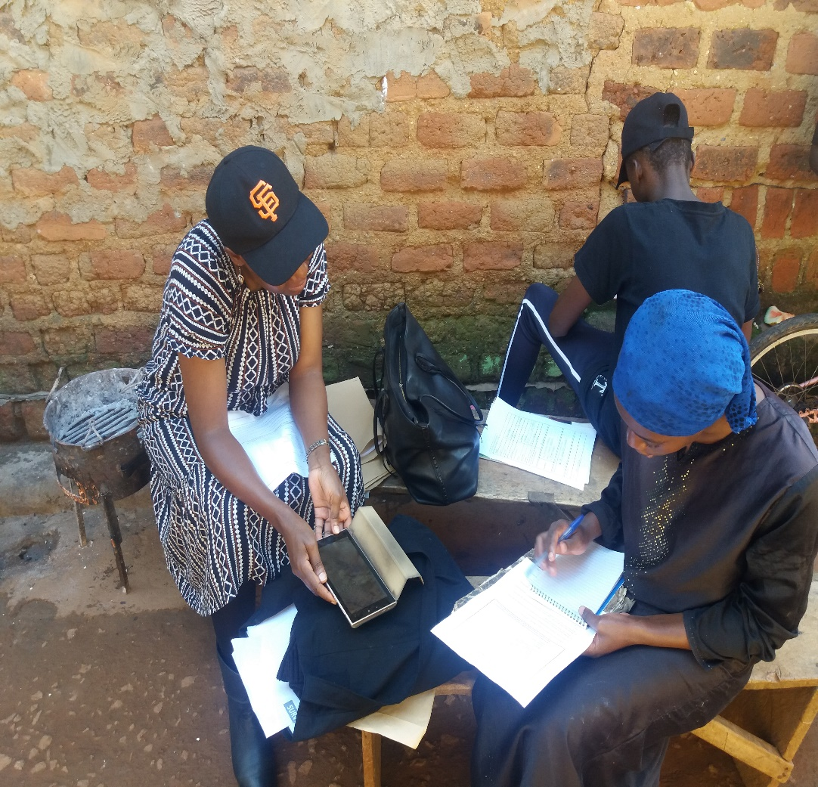
Rationale for the assessment
To contribute to the existing assessment methods and approaches that accurately measure how outcomes of schooling match with skills required in the workplace and everyday life
Notes:
Many of the 14-20 year old have left school and others have transitioned to secondary and tertiary education
We wanted to understand what levels of skills they acquired in common uses of English and mathematics. What difficulties are they likely to face in the workplace with regard to understanding instructions, providing necessary information in writing, working with measurements and tasks that require calculations?

Slide 4
Methodology
Household survey
01 District
10 EAs (5 rural, 5 urban) randomly selected
191 households
253 young people aged 14-20 assessed
Computer-assisted personal interview
Notes:
In and out of school – all assessed as long us they were in the 14-20 age bracket

Slide 5
The assessment tasks
Contextually relevant performance-assessment asks
Through complex, but flexible and adaptable processes of referral from one task to another, each individual assessed was placed on one of five levels in literacy and one of three levels of numeracy.
Notes:
- Worked in partnership with Oxford Policy Management
- Partly modelled on the tools that had been developed by Mozambique’s female economic empowerment programme (MUVA) (a DFID-funded programme in Mozambique), to assess everyday literacy and numeracy skills among young adults in Mozambique.

Slide 6
Overview of the Performance Tasks we developed
Reading and Writing Tasks | Numeracy Tasks
Completing a personal information form (START TASK for All) Interpreting workplace signs and symbols Reading and interpreting public notices Reading and interpreting an official application form (loan application) Reading of two contrasting texts and writing of answers to show understanding of conceptual meaning in unfamiliar text | Using basic numeracy skills such as recognition of shapes, putting numbers in order, recognising place value as well as basic money values Working with time and quantities Basic workplace calculations
Notes:
- Worked in partnership with Oxford Policy Management
- Partly modelled on the tools that had been developed by Mozambique’s female economic empowerment programme (MUVA) (a DFID-funded programme in Mozambique), to assess everyday literacy and numeracy skills among young adults in Mozambique.

Slide 7
Assessment Approach: Flexible and Adaptable*

Slide 8
FLOW CHART: MATH
N23 basic workplace calculations
All or nearly all correct
At least numeracy level 3
All or nearly all correct
Less than nearly all correct
Reading levels
Level 2, 3 or 4
N12 work with time and quantities
Mostly correct in both categories (some problems with harder questions)
Numeracy level 2
Level 1 or pre-level 1
All correct
Cannot do harder questions at all (total 2) but manages some of the easier ones (total 1)
Mostly correct in both categories
NPL12
use words for shapes
put numbers (cardinal and ordinal) into order
recognise place value
basic money values
Numeracy level 1
At most two categories with some correct
Numeracy pre-level 1

Slide 9
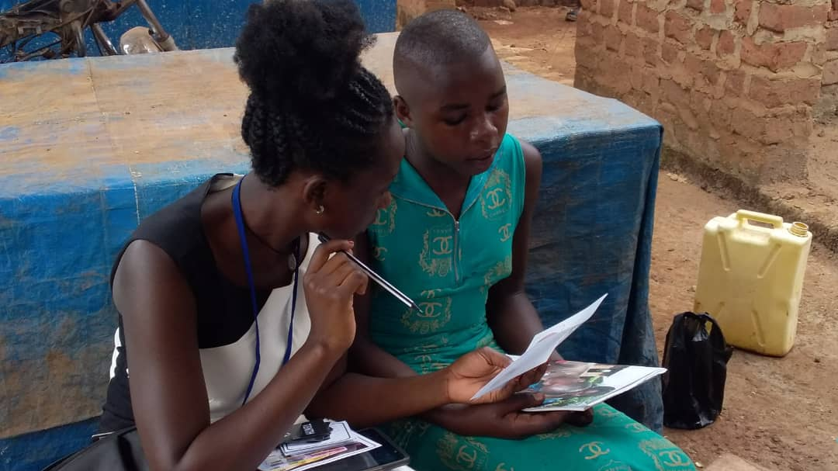
Selected findings from the assessment
Notes:
- Worked in partnership with Oxford Policy Management
- Partly modelled on the tools that had been developed by Mozambique’s female economic empowerment programme (MUVA) (a DFID-funded programme in Mozambique), to assess everyday literacy and numeracy skills among young adults in Mozambique.

Slide 10
Young people generally demonstrated low skills on workplace and everyday literacy
Notes:
4 out of every 10 young people assessed were at Level 3 (could read and interpret an official form and write a meaningful paragraph based on information provided).
3 out of every 10 young people assessed were at Pre-Reading Level 1 (could not identify common workplace signs and symbols).
Less than 1 out of every 10 young people assessed attained the highest Reading Level 4 i.e. demonstrated conceptual understanding of unfamiliar texts.

Slide 11
Similarly, young people generally demonstrated low skills on everyday numeracy
Notes:
2 out of every 10 young people assessed were at Numeracy Pre-Level 1 (could not recognise shapes, numbers, money, and place values)
6 out of every 10 young people assessed were at Numeracy Level 1 (could not go beyond recognition of shapes, numbers, money, and place values)
Less than 1 out of every 10 young people assessed reached the highest level of numeracy i.e. complete workplace calculations with ease (Numeracy Level 3+)

Slide 12
Skill levels varied according to schooling status
Numeracy
Literacy
Notes:
5 out of every 10 out-of-school young people assessed were at Pre-Reading Level 1 compared to 2 out of every 10 in-school young people who were at Pre-Reading Level 1
4 out of every 10 out-of-school young people assessed were at Numeracy Pre-level 1 compared to 1 out of every 10 in-school young people at Numeracy Pre-Level 1

Slide 13
Skill levels varied according to level of education completed
Numeracy
Literacy
Notes:
Those with some primary education were more likely to be placed at Pre-Reading Level 1 (64% of those in P2-4 & 57% of those in P5-7) compared with those with some secondary education (10%).
Those with some primary education were more likely to be placed at Numeracy Pre-Level 1 (50% of those in P2-4 & 31% of those in P5-7) compared with those with some secondary education (less than 10%).

Slide 14
Skill levels did not vary much by gender
Numeracy
Literacy
Notes:
3 out of every 10 girls and boys assessed were at Pre-Reading Level 1 (could not identify common workplace signs and symbols).
4 out of every 10 girls and 3 out of every 10 boys assessed attained either Reading Level 3 or 4 i.e. could read and interpret an official form and/or demonstrate conceptual understanding of unfamiliar texts.
2 out of every 10 girls and boys assessed were at Numeracy Pre-Level 1 (could not recognise shapes, numbers, money, and place values)
Less than 1 out of every 10 girls and boys assessed could successfully complete workplace calculations (Numeracy Level 3+)

Slide 15
Critical observations from the assessment
The findings suggest low workplace literacy and numeracy skills:
Especially among those who have left school
Implying that a large proportion of school leavers seem to remain ‘unskilled’ for employment purposes
Functional abilities lowest in mathematics: suggesting a more general failure of numeracy education and a need for action in this area
Notes:
*low functional abilities in tasks related to reading, writing and mathematics
*The importance of developing functional and lifelong learning outcomes in young people in an uncertain world such as the one we are facing in the context of Covid-19 cannot be overemphasised.

Slide 16
Thank you!
Contact Us! Uwezo Uganda,
Corner House, Suite B1
Plot 436/437, Mawanda Road
Kamwokya, Kampala
P.O Box 33275, Kampala, Uganda
Tel: +256-393-193-441
E-mail: info@uwezouganda.org
https://uwezouganda.org/

