Slide 1
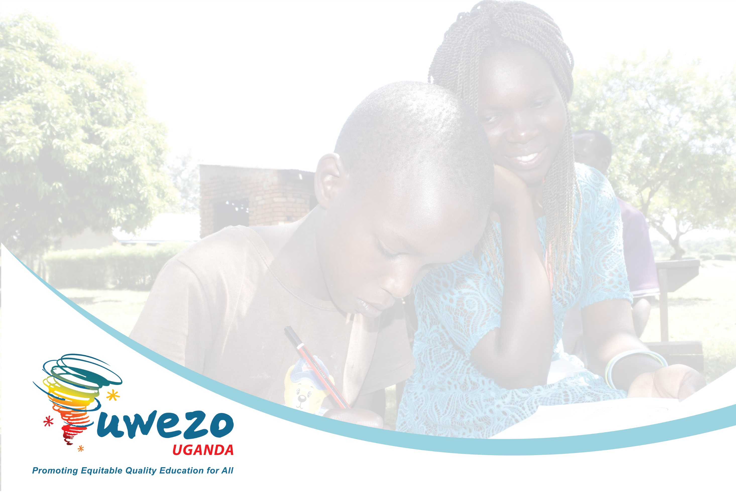
Trialling the International Common Assessment of Numeracy (ICAN) Tool with Hearing Impaired Learners and Children in Refugee Contexts
A presentation by Uwezo Uganda to the
Basic Education Working Group, Ministry of Education and Sports
Kampala, Uganda
02 February 2021

Slide 2

Background to the International Common Assessment of Numeracy (ICAN) Tool

Slide 3
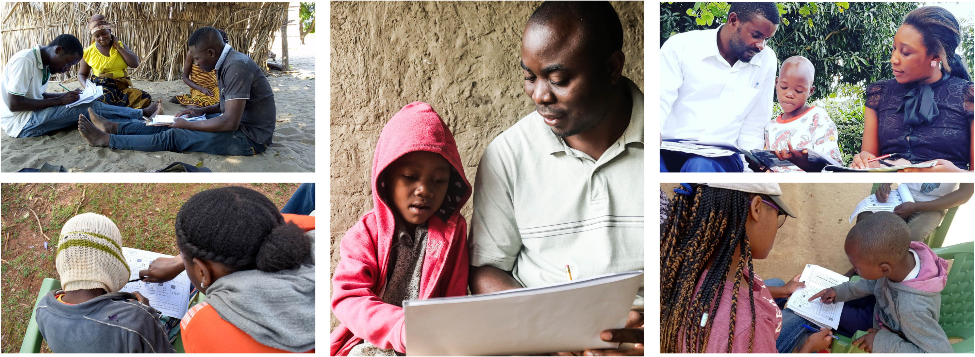
Mozambique
Uganda
Kenya
Tanzania
Kenya
Citizen-Led Assessment (CLA) approach originated in India in 2005
Adopted and adapted in other Global South contexts
People’s Action for Learning (PAL) Network formalised in 2015, now comprising members in 14 countries across 3 continents

Slide 4
CLA approach is relevant for the Global South
Core features of CLAs:
Conducted in households to include all children irrespective of schooling status
Implemented orally and one-on-one as many children cannot read
Cover foundational learning content taught in early primary classes
Administer simple-to-use tools, processes and produce easy-to-understand data to ensure wider engagement
Ensure collaboration with local stakeholders to create awareness and fuel local action

Slide 5
Global goal for education: SDG 4
SDG 4 focuses on ensuring “inclusive and equitable quality education and lifelong learning opportunities for all.”
Within Target 4.1, the first indicator (SDG 4.1.1) tracks the “proportion of children and young people achieving at least a minimum proficiency level in (i) reading and (ii) mathematics, by sex”
  (a) in Grade 2 or 3
Robust and regular data on learning outcomes are needed over time and across countries
Limited relevance of existing data to track progress towards SDG 4.1.1 for grades 2 or 3
Critical to measure learning early so that corrective measures can be implemented

Slide 6
ICAN - A comparable assessment for the Global South
The minimum proficiency level descriptor for numeracy under SDG 4.1.1 for primary class 2 or 3 requires children to demonstrate skills in number sense and computation, shape recognition and spatial orientation.

Slide 7
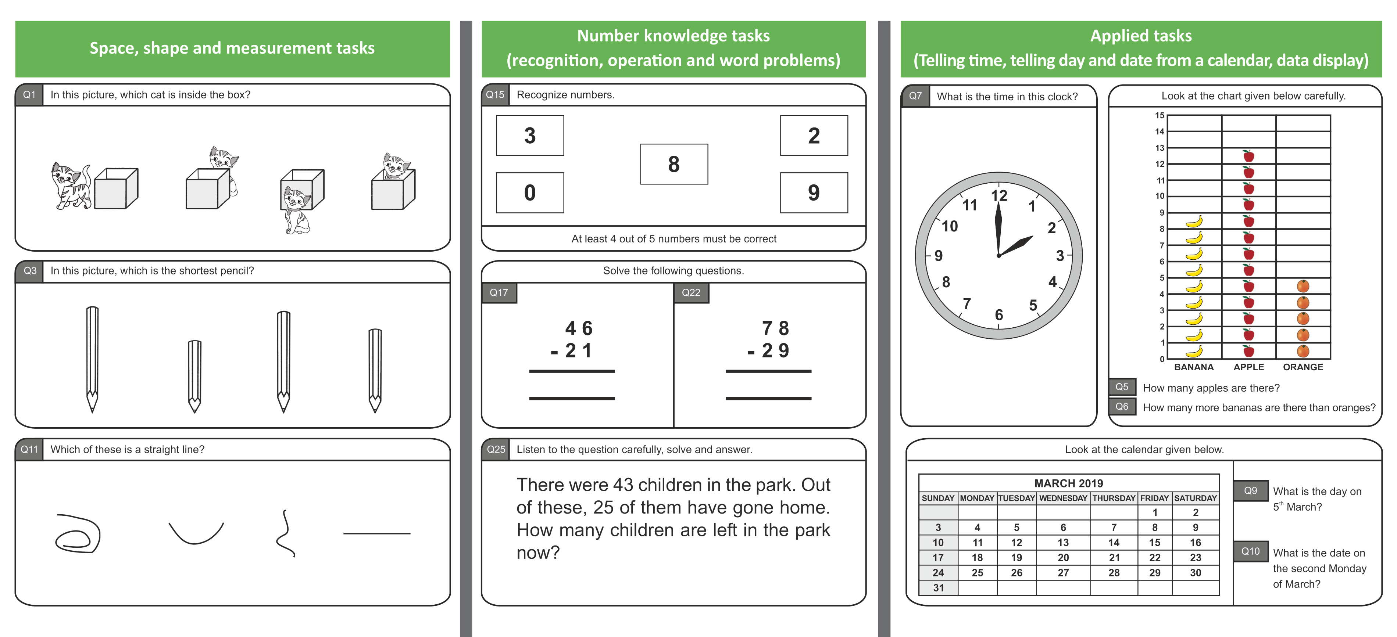
Sample tasks from the ICAN assessment tool
Within the region, ICAN assessment was conducted in 4 languages i.e. English, Kamba, Kiswahili and Portuguese

Slide 8


ICAN 2019: Large-scale household-based implementation
Proof of concept - feasibility of using common tools across different country contexts
ICAN 2019 retained all core features of the CLA architecture
Translation, training, data collection procedures based on PAL Network’s Data Quality Standards Framework (DQSF) in all participating countries
Implementation by PAL member organisations in collaboration with local partners
Conducted in 13 countries
60 randomly sampled rural communities in 1 district per country
District not an outlier in terms of learning outcomes
Administered in randomly sampled households to children in the age-group of 5-16 years
Each child assessed orally, one-on-one

Slide 9
Trialling the ICAN Tool with Special Education Needs Children (SEN) in Uganda
Rationale
Selected Special Needs:
Education for all = assessment for all
Leave no child behind
Establish suitability of the ICAN tool for children with special needs
Hearing Impairment
Refugee status

Slide 10

ICAN Trialling Sample
Conducted in September 2020 following Covid-19 SOPs
02 Districts (Mukono & Yumbe)
80 children assessed
20 with hearing impairment
20 without hearing impairment
20 located in a refugee settlement
20 located in the host community
Notes:
Hearing impaired children were affiliated to a school of the deaf in Mukono district (and residing in multiple Eas)

Slide 11
Distribution of the sample by Gender
District | Boys | Girls | Total
Mukono | 19 | 21 | 40
Yumbe | 24 | 16 | 40
Total | 43 | 37 | 80

Slide 12
Illustrative findings from Trialling ICAN with SEN Children
The purpose of this exercise was to test the feasibility of the tool in SEN contexts and to showcase the kinds of comparisons that the use of ICAN could facilitate

Slide 13
Number of children that answered correctly on each question – Irrespective of age and class

Slide 14
Comparison of female and male (P3-7)
The trend in performance generally follows a similar pattern
N=46

Slide 15
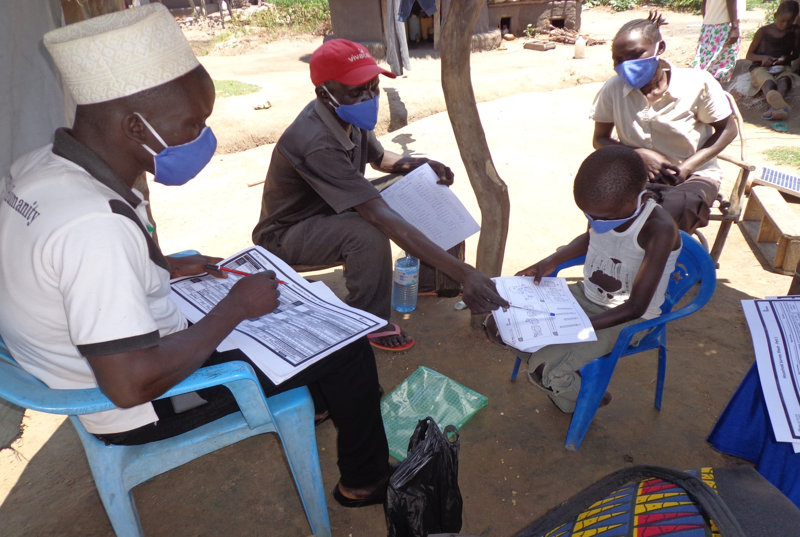

Slide 16
Refugee vs Host Community (National) Children - Yumbe (P3-7)
N=22
On average children in the refugee settlement were more proficient on all tasks (save for counting) than children from the host community

Slide 17
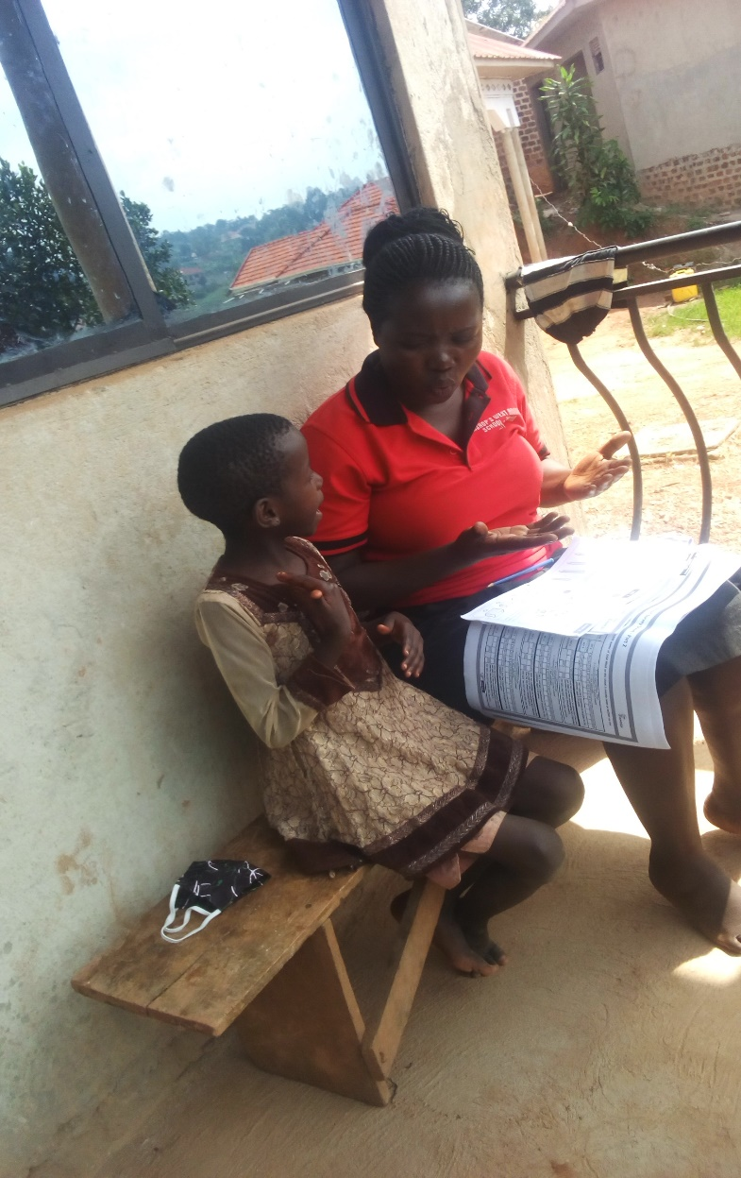

Slide 18
Comparison by Hearing Status- Mukono (P3-7)
N=24
Generally, children without any hearing impairment were more proficient at all tasks compared to those with hearing impairment.

Slide 19
Comparison of refugee or deaf children vs neither (P3-7)
N=46
Children who were neither in a refugee settlement nor had hearing difficulty performed slightly better than their counterparts who had either difficulty hearing or living in a refugee settlement.

Slide 20
As the clock ticks to 2030 . . .
We need less top-down and more granular measurements of foundational learning that can lead to rapid corrective action
ICAN is:
Open source; currently available in English in Uganda (but 11 languages across 13 countries)
Most tasks are aligned to primary grade 3 or lower of the UNESCO Global Proficiency Framework: https://www.edu-links.org/sites/default/files/media/file/Global%20Proficiency%20Framework_01032020.pdf
Suitable for use in both household and school settings and children with Special Needs
Simple and quick to administer and understand, therefore easy to scale

Slide 21
Prayer to the BEWG
Make use of the ICAN tool as a measure of foundational learning to enable corrective action. The tool is applicable to a variety of contexts, including those with children with special needs
Support the scaling up of ICAN in Uganda and utilise the evidence to inform policy and practice

Slide 22
Thank you!
Contact Us!
Uwezo Uganda,
Corner House, Suite B1
Plot 436/437, Mawanda Road
Kamwokya, Kampala
P.O Box 33275, Kampala, Uganda
Tel: +256-393-193-441
E-mail: info@uwezouganda.org
https://uwezouganda.org/

