Slide 1

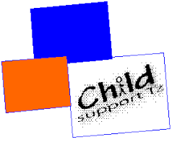

Voices from the South: Classroom environment & learning outcomes-experiences from East Africa
Comparative International Education Society (CIES) Conference
19/20 April 2022, Minneapolis, USA / EA

Slide 2
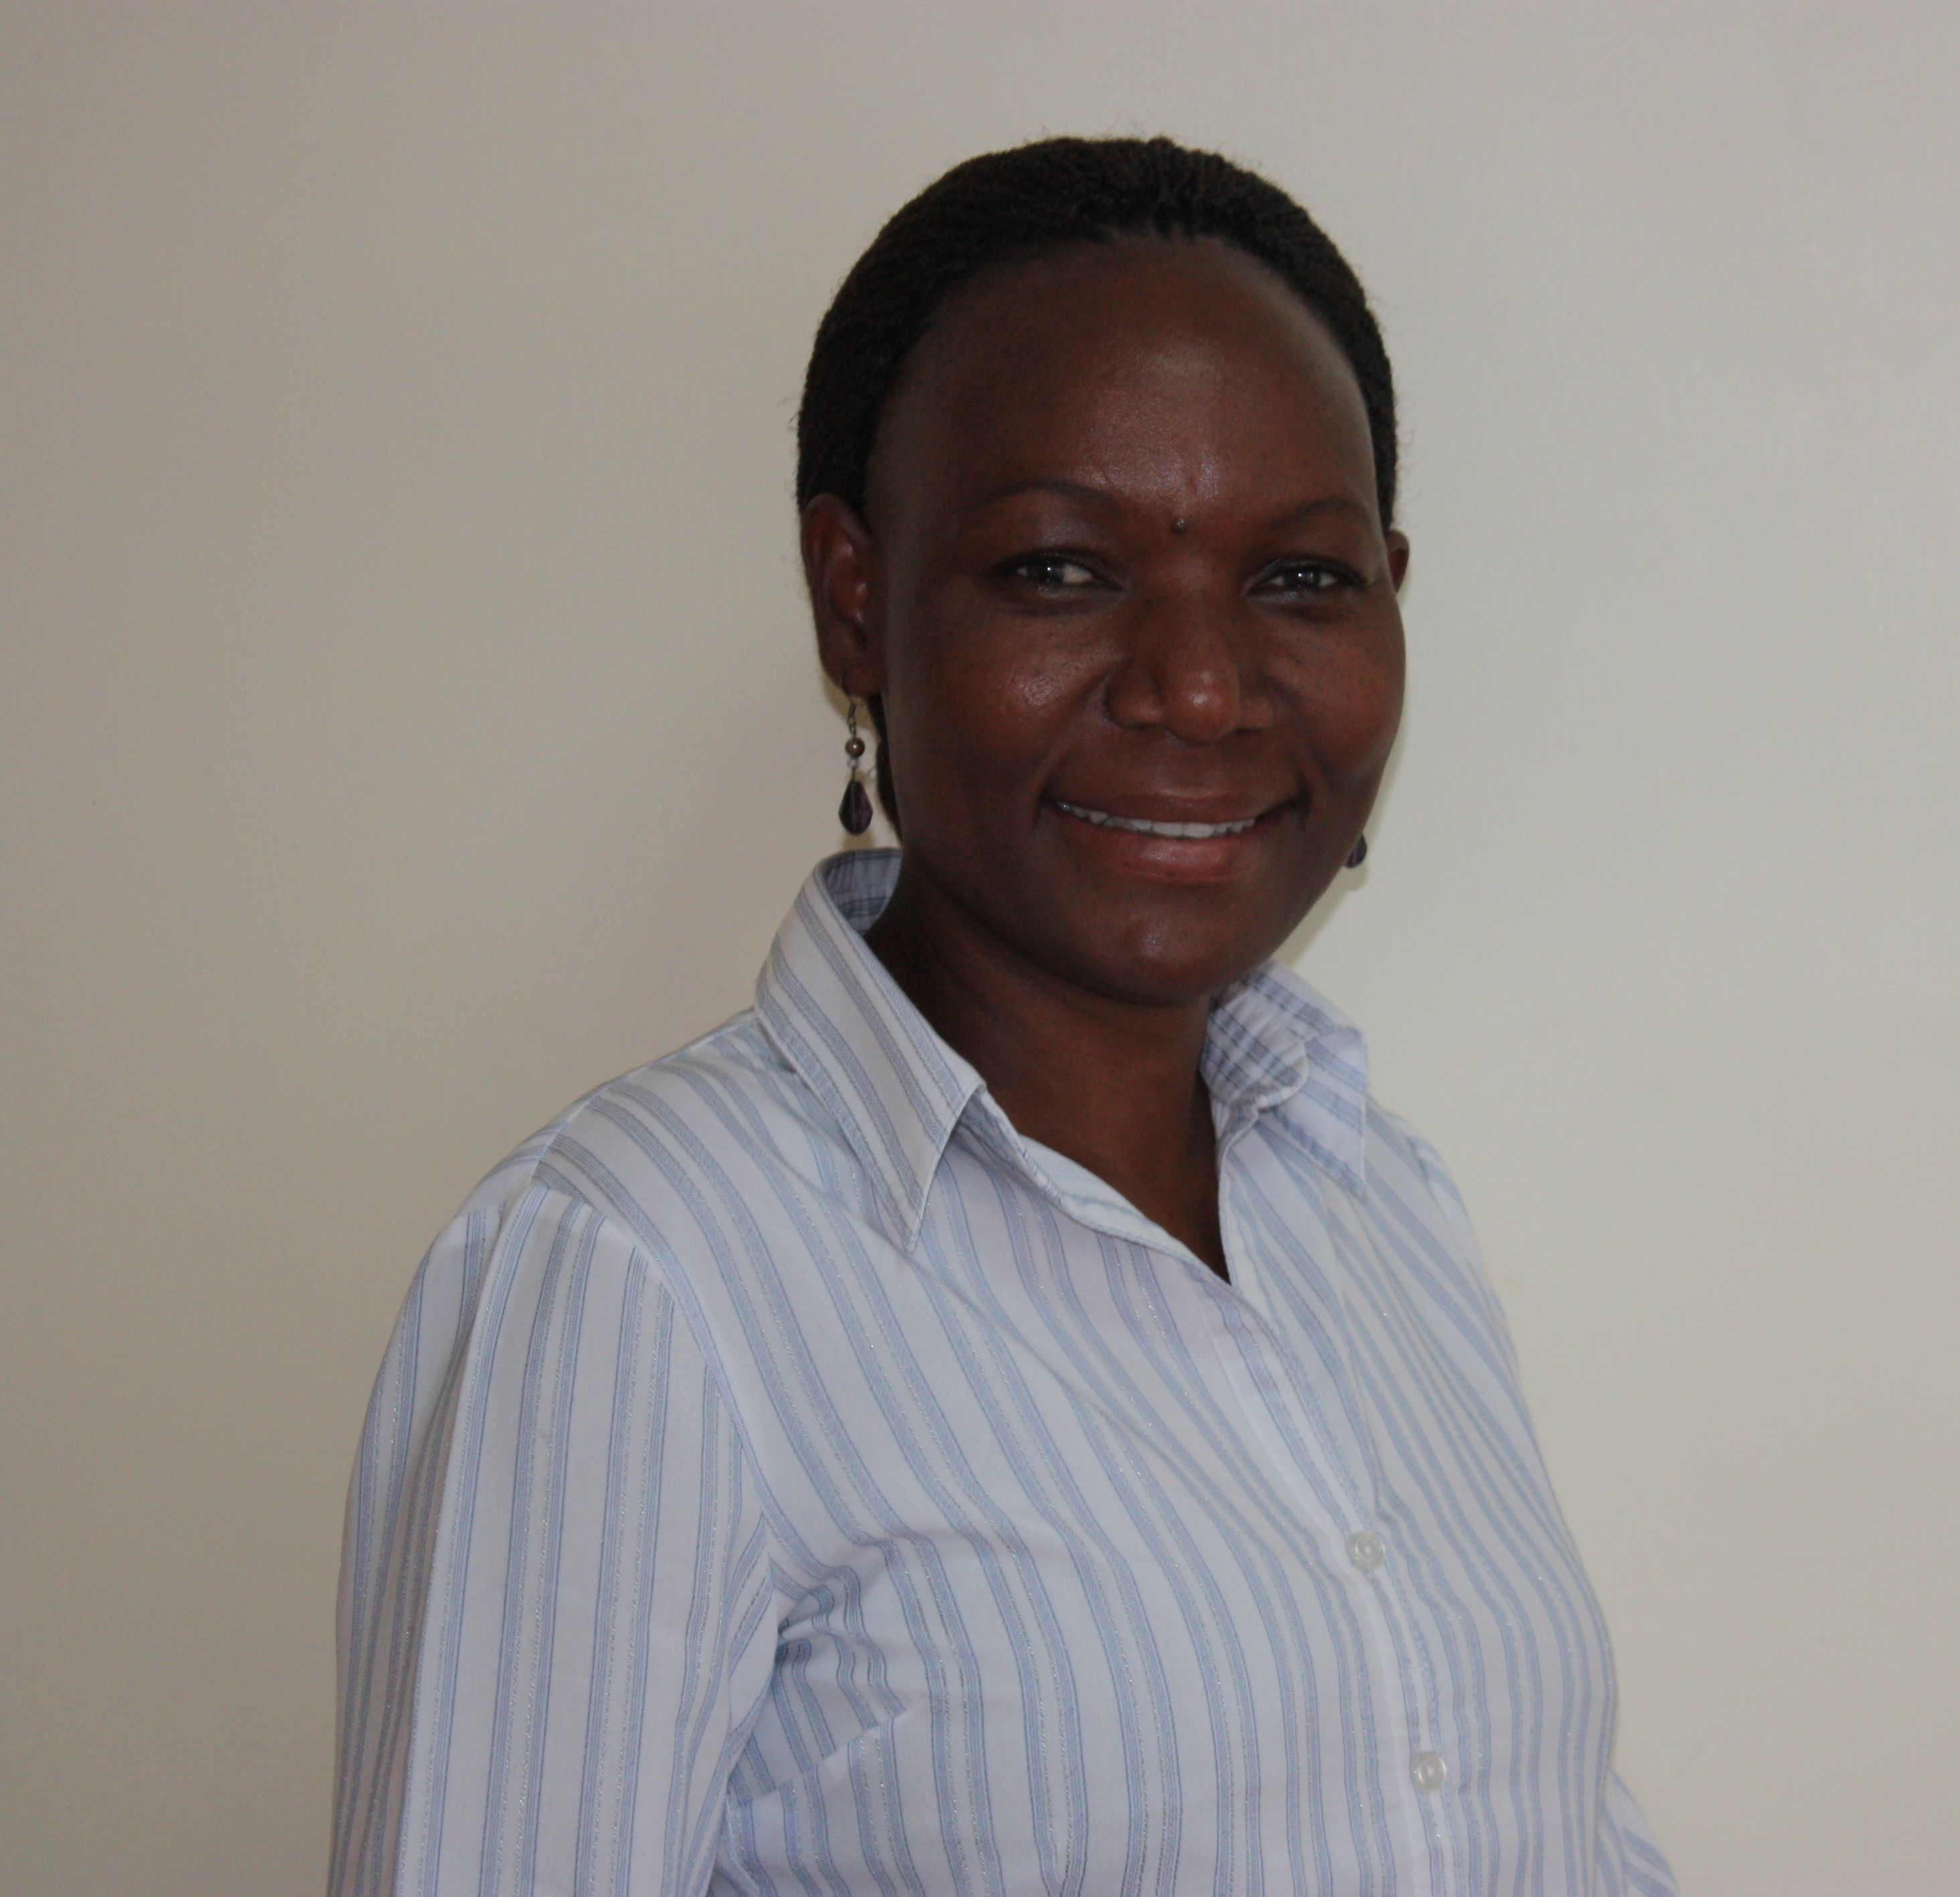
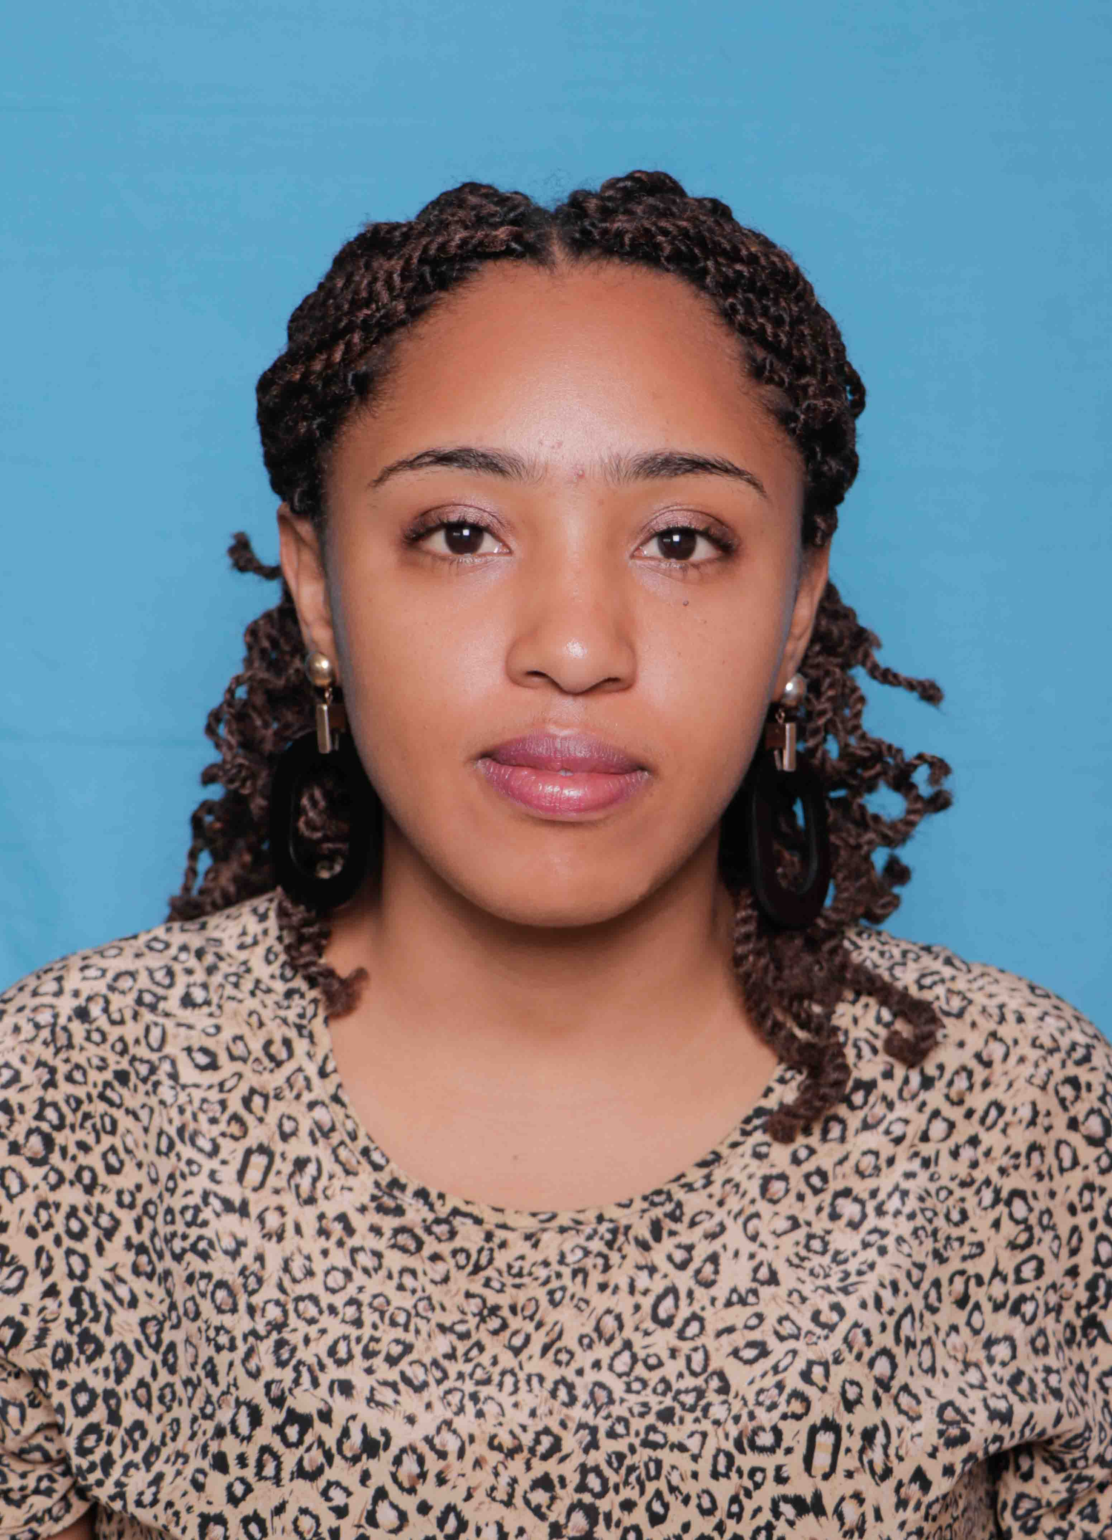
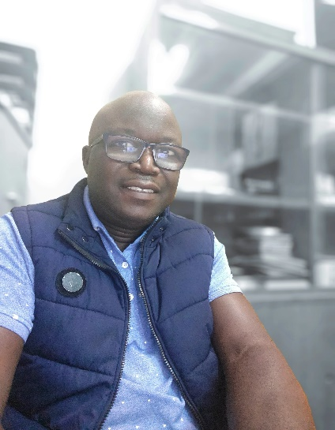
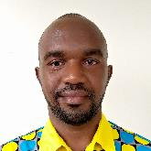
Panelists
Mary Goretti Nakabugo
Mehrab Hildergard
Jackson Agufana
Modern Karema

Slide 3
About the Panelists
Hildergade Mehrab is the project manager for an inclusive education project supporting children with disabilities across 42 schools in Mbeya, Tanzania. She has been the driving force over the project’s entire 6 years of operation and has been behind its remarkable successes, including the enrolment of 500 children with disabilities who before had been living lives of neglect, with no schooling.
Modern Karema works as the Uganda Country Director for STIR Education, which is an education system strengthening program working in Uganda, Ethiopia, India and Indonesia to reignite intrinsic motivation in the education system so that every official, teacher and learner can learn and improve. Before that, he was in senior program and government relations leadership roles in Educate!, in Uganda and Rwanda. He is also the Uganda Country Co-Lead for RELI-the Regional Education Learning Initiative-a regional umbrella body of over 70 Civil Society Organisations in East Africa geared towards achieving equitable learning outcomes.
Hassan Agufana Jackson is a disability advocate and project specialist. He heads the Secretariat of the Kenya Union of the Blind (KUB), a national organization working to promote social inclusion for persons with visual impairments in Kenya. KUB works with state and non-state actors to champion for the promotion of special needs education (SNE). An Alumni of Oral Roberts University, Jackson has previously served as the regional programmes director of the African Union of the Blind (AFUB) and the Kenya country SNE advisor of the Lutheran Hour Ministries International (LHMI).

Slide 4
Voices from the South: Classroom environment & learning outcomes-experiences from East Africa
‘Teachers are teaching, but children are not learning’ – has become a common phrase in Africa.
Whereas teachers come into classrooms with academic content, classroom environments make it hard for learning to happen.
Notes:
Can reference Uwezo findings in East Africa

Slide 5
Focus of the Panel
Sharing how selected programs within RELI support improved learning environments and improved learning outcomes.

Slide 6
The papers
The first paper, by Mehrab, shares how one organisation in Tanzania has improved delivery of education to marginalized children as well as children with disabilities living in extreme poverty through a child-to-child approach
Notes:
3rd bullet: aimed at developing a set of student competencies that provides meaningful learning pathways for all categories of students, namely those who can continue with an ‘academic’ education after lower secondary, those who can join vocational training courses, and those who choose to directly enter the workforce after Senior Four (S4).

Slide 7
The papers
The second paper, by Jackson, demonstrates how one organisation in Kenya is supporting inclusion of persons and children with visual impairments through advocating policies that support special needs education (SNE).
Notes:
3rd bullet: aimed at developing a set of student competencies that provides meaningful learning pathways for all categories of students, namely those who can continue with an ‘academic’ education after lower secondary, those who can join vocational training courses, and those who choose to directly enter the workforce after Senior Four (S4).

Slide 8
The papers
The third paper, by Modern Karema, demonstrates how one organisation in Uganda is contributing to achieving the foundations of lifelong learning through an education system strengthening program that supports re-igniting intrinsic motivation.

