Slide 1
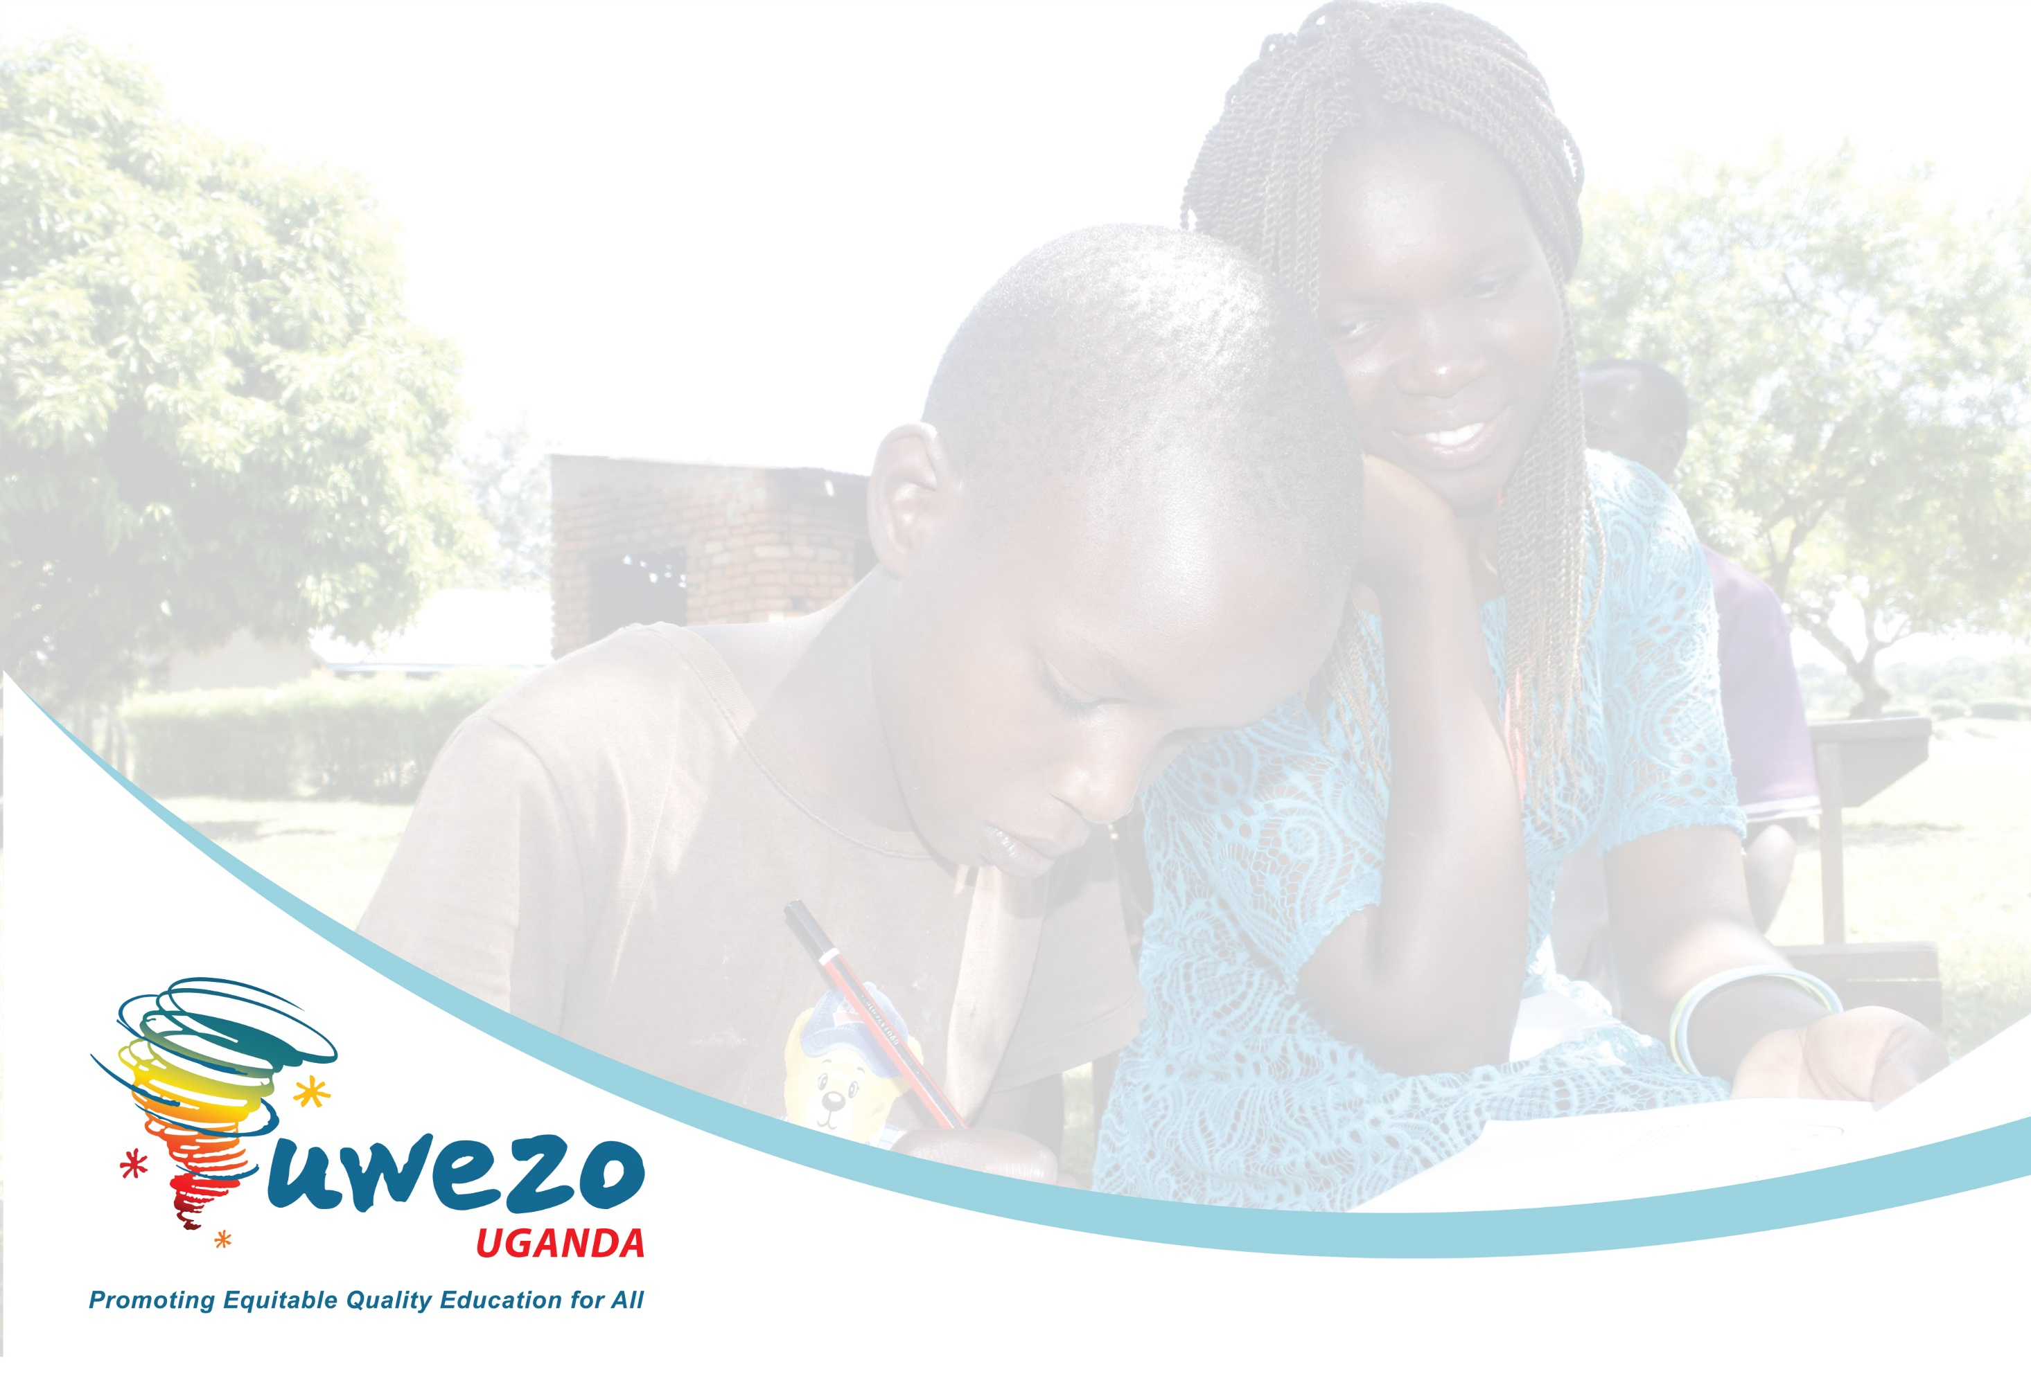
Models of curriculum design, development and implementation to enhance holistic learning
Mary Goretti Nakabugo, PhD
Executive Director
Uwezo Uganda
Keynote Speech at the Launch of the NCDC 50-Year Anniversary Celebrations
Hotel Africana, Kampala
13th July 2022

Slide 2

The central concept is ‘holistic learning’ or what some practitioners call ‘Whole-Child Development’ (WCD)*
Notes:
The central concept in the keynote…
Every curriculum or program of study is developed for a purpose - not for the sake of it.
If I am to flip the keynote address topic I would ask? If we want the education system to develop and produce holistic children learners, what kind of curriculum development model would facilitate this?
For us to answer this question, we would need to define what we mean by ‘holistic learning’ or whole child develop and then search for the best channel (curriculum) through which we can achieve this.

Slide 3
What is holistic learning?
‘Holistic learning’ = processes of learning that involve the ‘whole person’*.
It cuts across the three domains of Bloom’s taxonomy of learning.
Notes:
* (mental, physical and emotional elements). Some would also include the spiritual element
Benjamin Bloom was an American educational psychologist who organised learning objectives into a taxonomy of learning classified into three main domains,

Slide 4
Taxonomy = Classification e.g. beverages
*Taxonomy = Classification e.g. classification of beverages
Notes:
As an undergraduate student, I learnt the term taxonomy very theoretically. Little did I know that it meant ‘classification of things’ e.g. beverages of foods

Slide 5
Bloom’s Taxonomy*
Notes:
Cognitive: defining knowledge classification (Remembering, understanding, applying, analyzing, evaluating, creating)
Affective: (defining behaviors that correspond to attitudes and values.)
Psychomotor: (Defining physical skills)

Slide 6
Whole-Child Development (WCD)
Aims to develop the whole child*
Recognises that all children require a range of knowledge, skills, experiences, and core values*
(Porticus and ACER, 2022: “Measuring what matters: Insights on the value of whole child development)
Notes:
* physically, socially, emotionally, and academically with the active engagement and support of the community
* that will enable them to engage as productive and ethical citizens.

Slide 7
Which models of curriculum design, development and implementation would best facilitate holistic learning/WCD?

Slide 8
Which curriculum development models?
Traditionally, there are different types of curriculum models
e.g. linear/rational/objectives models (e.g. Ralph Tyler or Hilda Taba models);
Cyclic models e.g. Wheeler model (but still fixed)
Or dynamic model (e.g. Malcolm Skilbeck model)– steps are done systematically but flexible i.e. no fixed starting point
Notes:
The different elements are seen as flexible ,interactive and modifiable. The steps are done systematically but do not follow a locked sequence or a fixed starting point.

Slide 9
But all these models have one thing in common:
Evaluation/assessment coming at the end / as an after thought
See examples..
Notes:
The different elements are seen as flexible ,interactive and modifiable. The steps are done systematically but do not follow a locked sequence or a fixed starting point.

Slide 10
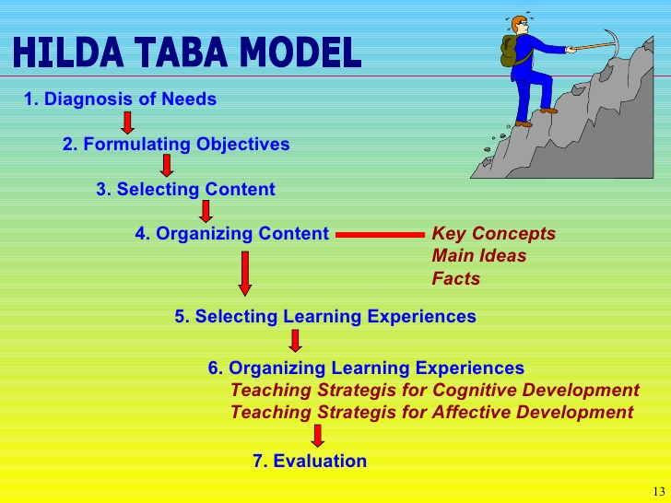

Slide 11
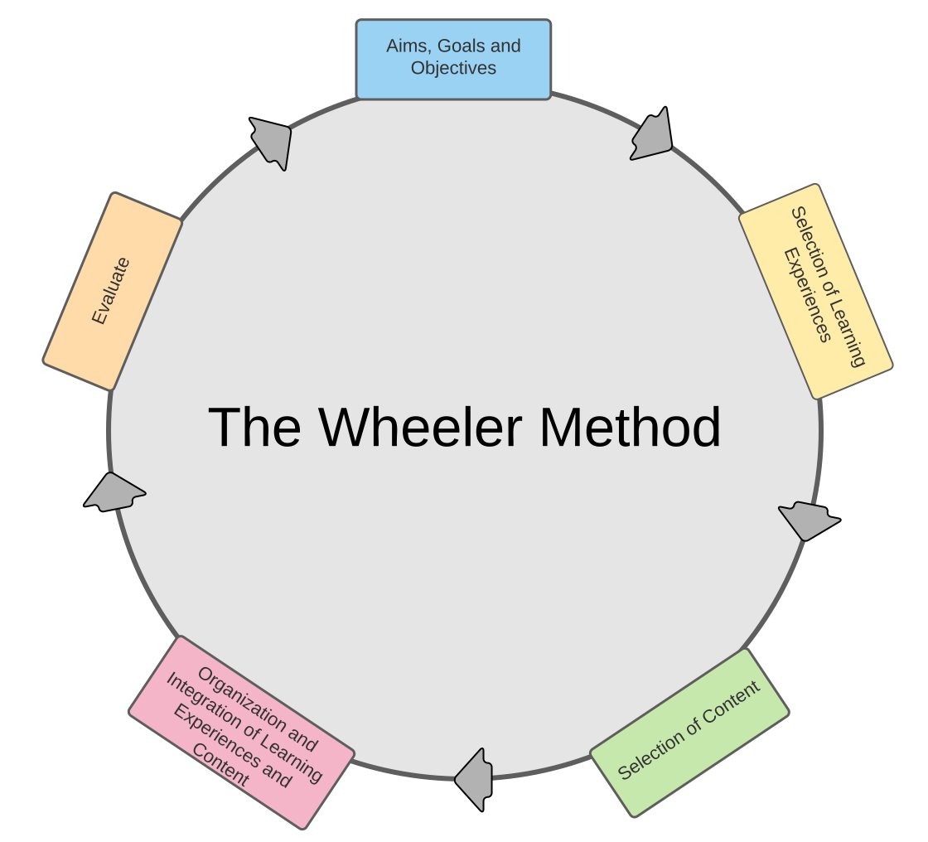
Wheeler’s: Cyclic but qualitatively not too different

Slide 12
Skilbeck’s dynamic model – not too different
Situational analysis
Goal formulation
Programme-building*
Interpretation and implementation
Monitoring, assessment and feedback
Notes:
* (selection of content, the sequencing of teaching-learning, choice of teaching/learning materials, etc)

Slide 13
What if we flipped it – Goals at the centre and evaluation/assessment not an after thought?
Notes:
Much of my professional work is in assessment. Assessment has an effect of driving what is taught and learnt.

Slide 14
Backwards design / Goals-based model*

Slide 15
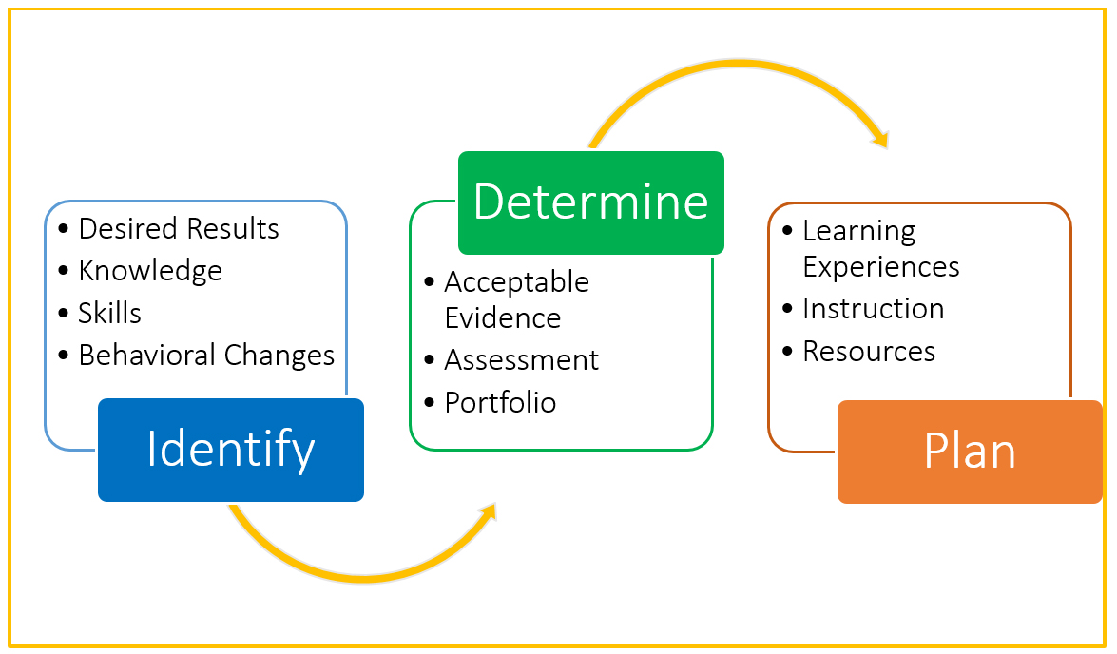
The Backwards Design Process*
Notes:
*Begin at the end and work backwards

Slide 16
In Simple Terms, Backwards Design…
Focuses on what the learners need (learner-centred)
Articulates curriculum goals beyond content coverage
Promotes selection of strategies to achieve goals beyond content coverage
Ensures that authentic assessment is built in, not an after-thought

Slide 17
What is different in Backwards Design/Goal-based?
Curriculum alignment & hence coherence
More emphasis on learning than on coverage
Holistic approach, and not knowledge as discrete pieces
Notes:
As a design approach backwards design, helps counter the mentality of trying to teach the curriculum/syllabus/textbook. Setting a clear overarching objective that focuses on the level of understanding you want students to walk away with allows a teacher to selectively curate only content that will get students to that end goal.

Slide 18
The Backwards Model in Practice: Two Examples
Non-textbook example: How I learnt how to drive
Learning collaboration: Example from ALiVE*
Notes:
Collaboration:
* Goal: What do people who are able to collaborate do? They are able to complete tasks or solve a problems in collaboration with others. The Goal could be: Students are able to work with others to solve a given problem/task
* How will I know they are able to collaborate? (Performance indicators)
Communication / Ability to communicate (Ability to speak and listen)
Negotiation / Ability to express own opinion and ability to accept others opinion
Working together / participation
* Now set teaching/learning experiences

Slide 19
Thank you!
Contact Us!
Uwezo Uganda,
Corner House, Suite B1
Plot 436/437, Mawanda Road
Kamwokya, Kampala
P.O Box 33275, Kampala, Uganda
Tel: +256-393-193-441
E-mail: info@uwezouganda.org
https://uwezouganda.org/

