Slide 1
Using facilitated advocacy to engage teachers in dialogue with other community actors for improved learning outcomes
Mary Goretti Nakabugo, PhD
Uwezo Uganda

Slide 2
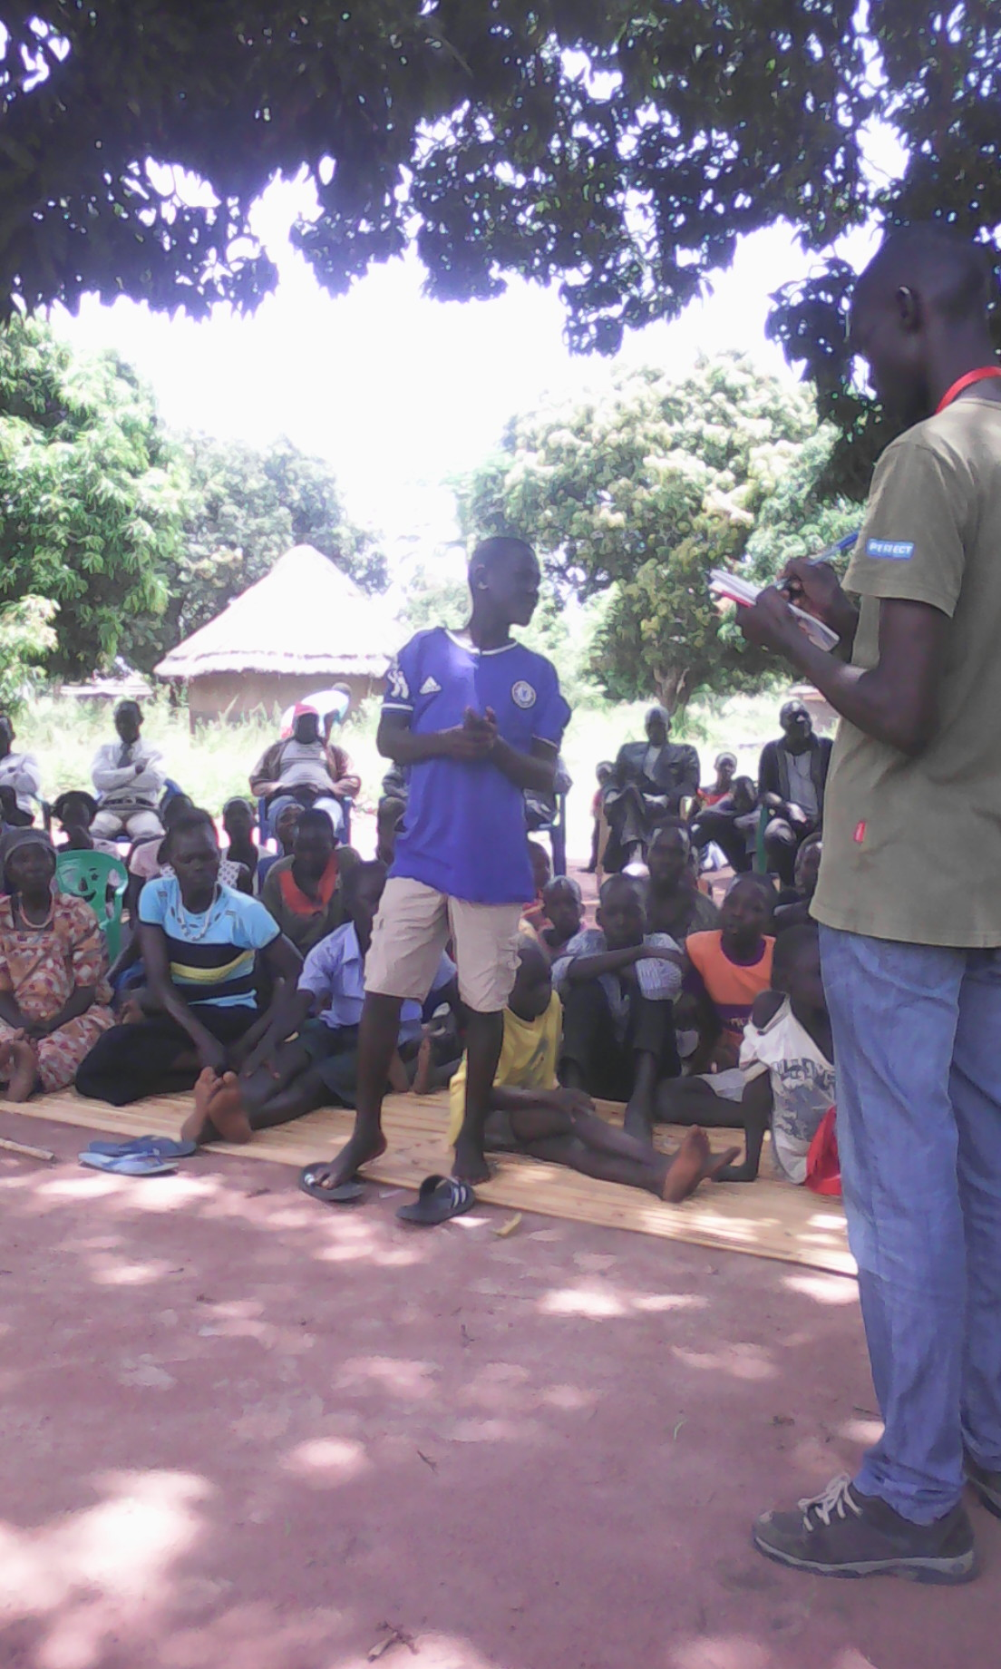
Are Our Children Learning?
Uwezo
Citizen-led assessment -- nation-wide, regional
Village report cards and meeting
A role for facilitated advocacy?

Slide 3
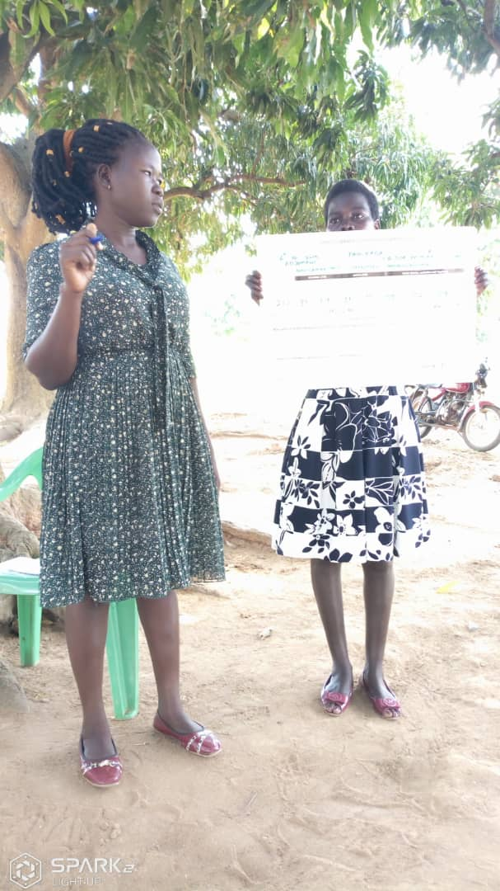
Making It Easier to Take Action
What is facilitated advocacy? (Haylor and Savage 2019)
Advocacy in Uwezo / community engagement
The SDGs

Slide 4
What is Facilitated Advocacy?
Facilitated advocacy is an approach to development initiatives that enables people to engage with each other equitably and to identify desired changes in policy and practice.
Developed over several years in Asia and Africa, the facilitated advocacy approach grew out of experiences of listening to the voices of people in change processes that place the so-called target group at the centre of development efforts, and that support them to advocate for what they value (Haylor and Savage, 2019)
The promotion of a facilitated advocacy approach is also in alignment with the Sustainable Development Goals (SDGs) agenda to “leave no one behind”,

Slide 5
Training in, Piloting and Evaluating the Approach
Equitable participation
Children’s, parents’, teachers’ and local leaders’ involvement and participation
Consensus-building
Most significant change stories (Davies and Dart 2005)

Slide 6
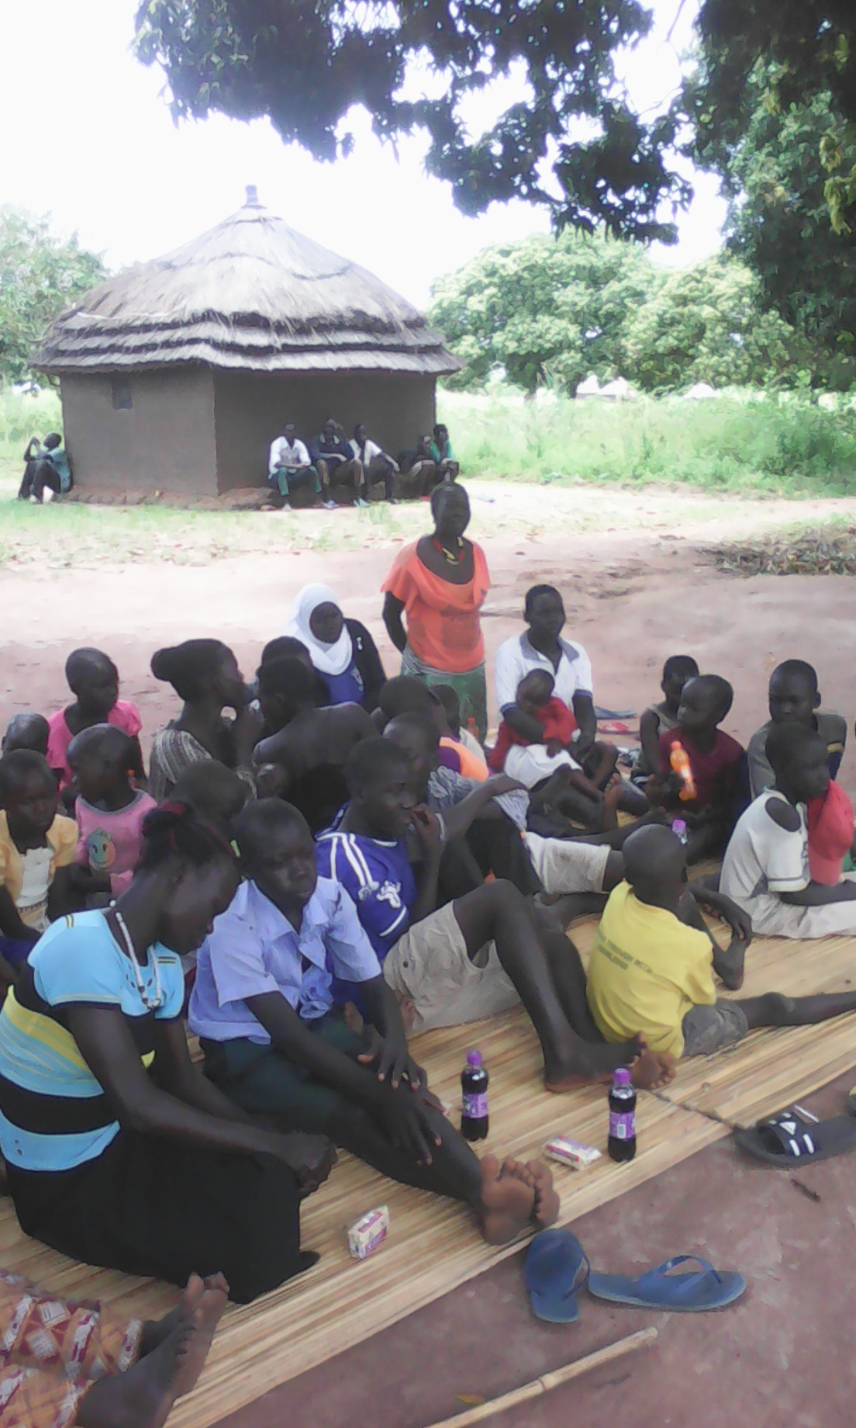
Learning from the Pilot and Implications for Uwezo
Facilitation
Advocacy
Training
Monitoring and evaluation

Slide 7
Some key insights
A common theme seemed to be parents’ realisation of their own responsibilities for their children’s learning, and more broadly, a more widely shared understanding across the community of roles, rights and responsibilities in the learning of the village’s children.

Slide 8
A Role for Facilitated Advocacy in Education
Centering children, parents, teachers and local leaders in the conversation
Nurturing community-grown solutions
… so as to …
Influence local and national policy and practice

Slide 9
Collective commitments included;
Addressing issues of teacher and children absenteeism
Addressing issues of teacher shortages
Issues of safe drinking water for children at school
Parents checking the children’s exercise books and monitoring them at school
Issues of pre-school provision
Attendance of parents-teacher meetings

Slide 10
References
Graham Haylor and William Savage 2019 Facilitated Advocacy for Sustainable Development: An Approach and Its Paradoxes. Oxford, England and New York, USA: Routledge.
Rick Davies and Jess Dart 2005 The 'Most Significant Change' Technique - A Guide to Its Use. Funded by CARE International, United Kingdom; Oxfam Community Aid Abroad, Australia; Learning to Learn, Government of South Australia; Oxfam New Zealand; Christian Aid, United Kingdom; Exchange, United Kingdom; Ibis, Denmark; Mellemfolkeligt Samvirke (MS), Denmark; Lutheran World Relief, United States of America.

Slide 11
Thank you!
Contact Us! Uwezo Uganda,
Corner House, Suite B1
Plot 436/437, Mawanda Road
Kamwokya, Kampala
P.O Box 33275, Kampala, Uganda
Tel: +256-393-193-441
E-mail: info@uwezouganda.org
https://uwezouganda.org/
Twitter: @UwezoUganda
@MNakabug
Notes:
Invite those interested in collaboration and share your business cards

