Slide 1
Implementing Curriculum Reforms in Under-resourced Contexts What can we learn from Uganda?
Comparative International Education Society (CIES) Conference
22/23 April 2022, Minneapolis, USA / EA

Slide 2
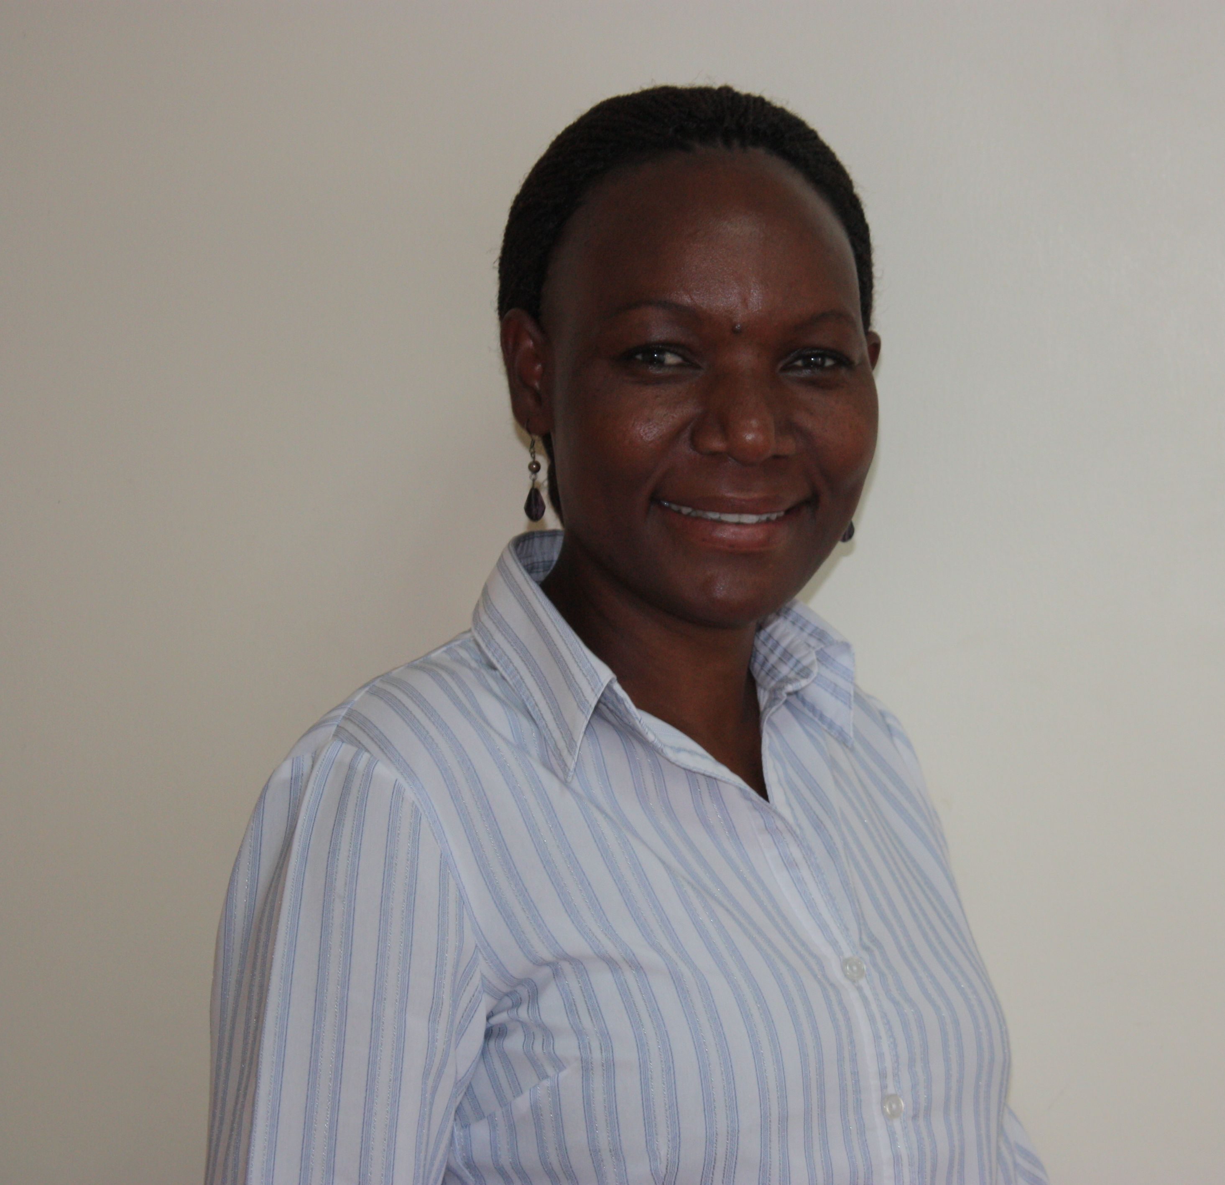
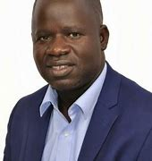
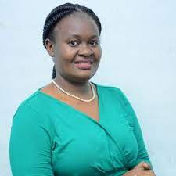
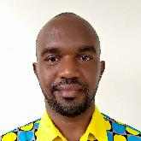
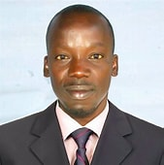
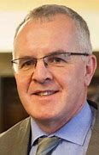
Panelists and Discussant
Mary Goretti Nakabugo
Dr Patrick Ojok
Jane Sebuyungo & Modern Karema
Emmy Zoomlamai
Prof Paul Conway
Notes:
Dr Patrick Ojok, Senior Lecturer in Special Needs Education – Kyambogo University
Jane Ssebuyungo - Senior Programme Manager Design, STiR Education
Modern Karema – Country Director, STiR Education
Emmy Zoomlamai Okello - Executive Director, Foundation for Inclusive Community Help (FICH)
Prof Paul Conway (Discussant) – Professor and Deputy Head: School of Education, University of Limerick, Ireland

Slide 3
Implementing Curriculum Reforms in Under-resourced Contexts
The quality of an education [largely] depends on the quality of its curriculum.
Lack of employable skills among graduates is usually blamed on the school curriculum

Slide 4
The Ugandan Context
Uganda’s education system has been criticised for being examination-ridden
It has also been criticised for producing graduates who can hardly meet the market demand
A labour market survey recommended a radical review of the secondary education curriculum (NCDC, 2021)
Notes:
3rd bullet: aimed at developing a set of student competencies that provides meaningful learning pathways for all categories of students, namely those who can continue with an ‘academic’ education after lower secondary, those who can join vocational training courses, and those who choose to directly enter the workforce after Senior Four (S4).

Slide 5
The Ugandan Context: Curriculum reform
Comprehensive review and a new lower secondary curriculum introduced at the beginning of the 2020 school calendar.
The new curriculum is competency-based, with a focus on generic skills and values
A focus on Core Values, Key Learning Outcomes, Generic Skills, eight Learning Areas and five Cross-cutting issues.
Notes:
Generic skills such as

Slide 6
Focus of the Panel
Early this year, we undertook a study to understand how teachers have conceived and implemented the new curriculum.
Driven by the need to take stock of progress made and teachers’ experiences, and generate lessons early enough.
Notes:
3rd bullet: aimed at developing a set of student competencies that provides meaningful learning pathways for all categories of students, namely those who can continue with an ‘academic’ education after lower secondary, those who can join vocational training courses, and those who choose to directly enter the workforce after Senior Four (S4).

Slide 7
The papers
Dr Patrick Ojok’s paper sets out the key curriculum intentions and expectations and discusses selected findings on the teachers’ perceptions of preparedness to implement the new curriculum.
Jane Sebuyungo and Modern Karema’s paper examines the roles of different stakeholders in the implementation process and analyses the teachers’ interpretation of the new curriculum and how they have attempted to implement it
Emmy Zoomlamai and Mary Goretti Nakabugo’s paper probes into how assessment in the new curriculum at classroom level has been implemented and discusses selected findings on how teachers have perceived the new assessment
Notes:
3rd bullet: aimed at developing a set of student competencies that provides meaningful learning pathways for all categories of students, namely those who can continue with an ‘academic’ education after lower secondary, those who can join vocational training courses, and those who choose to directly enter the workforce after Senior Four (S4).

