Slide 1




Implementing Curriculum Reforms in Under-resourced Contexts
What can we learn from Uganda?
Comparative International Education Society (CIES) Conference
22/23 April 2022, Minneapolis, USA / EA

Slide 2
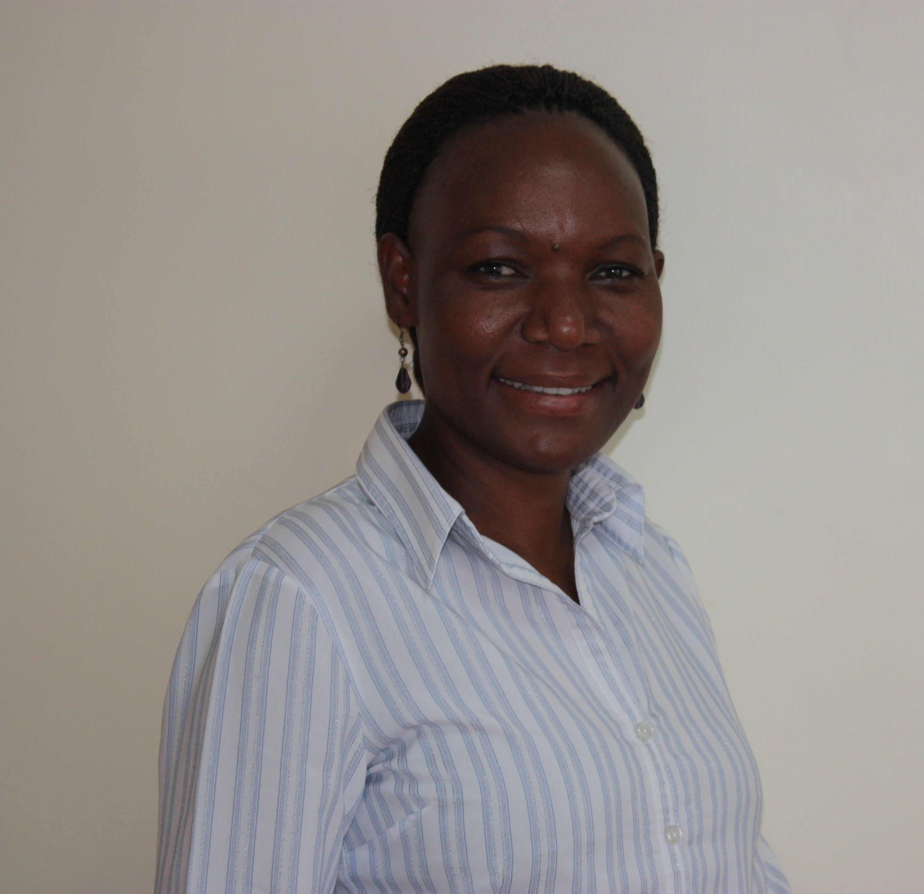
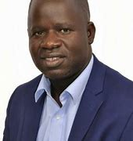
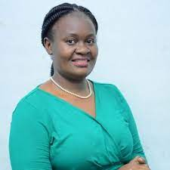
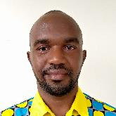

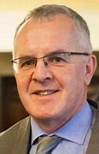
Panelists and Discussant
Mary Goretti Nakabugo
Dr Patrick Ojok
Jane Sebuyungo & Modern Karema
Emmy Zoomlamai
Prof Paul Conway
Notes:
Dr Patrick Ojok, Senior Lecturer in Special Needs Education – Kyambogo University
Jane Ssebuyungo - Senior Programme Manager Design, STiR Education
Modern Karema – Country Director, STiR Education
Emmy Zoomlamai Okello - Executive Director, Foundation for Inclusive Community Help (FICH)
Prof Paul Conway (Discussant) – Professor and Deputy Head: School of Education, University of Limerick, Ireland

Slide 3
Implementing Curriculum Reforms in Under-resourced Contexts
The quality of an education [largely] depends on the quality of its curriculum.
Lack of employable skills among graduates is usually blamed on the school curriculum

Slide 4
The Ugandan Context
Uganda’s education system has been criticised for being examination-ridden
It has also been criticised for producing graduates who can hardly meet the market demand
A labour market survey recommended a radical review of the secondary education curriculum (NCDC, 2021)
Notes:
3rd bullet: aimed at developing a set of student competencies that provides meaningful learning pathways for all categories of students, namely those who can continue with an ‘academic’ education after lower secondary, those who can join vocational training courses, and those who choose to directly enter the workforce after Senior Four (S4).

Slide 5
The Ugandan Context: Curriculum reform
Comprehensive review and a new lower secondary curriculum introduced at the beginning of the 2020 school calendar.
The new curriculum is competency-based, with a focus on generic skills and values
A focus on Core Values, Key Learning Outcomes, Generic Skills, eight Learning Areas and five Cross-cutting issues.
Notes:
Generic skills such as

Slide 6
Focus of the Panel
Early this year, we undertook a study to understand how teachers have conceived and implemented the new curriculum.
Driven by the need to take stock of progress made and teachers’ experiences, and generate lessons early enough.
Notes:
3rd bullet: aimed at developing a set of student competencies that provides meaningful learning pathways for all categories of students, namely those who can continue with an ‘academic’ education after lower secondary, those who can join vocational training courses, and those who choose to directly enter the workforce after Senior Four (S4).

Slide 7
The papers
Dr Patrick Ojok’s paper sets out the key curriculum intentions and expectations and discusses selected findings on the teachers’ perceptions of preparedness to implement the new curriculum.
Jane Sebuyungo and Modern Karema’s paper examines the roles of different stakeholders in the implementation process and analyses the teachers’ interpretation of the new curriculum and how they have attempted to implement it
Emmy Zoomlamai and Mary Goretti Nakabugo’s paper probes into how assessment in the new curriculum at classroom level has been implemented and discusses selected findings on how teachers have perceived the new assessment
Notes:
3rd bullet: aimed at developing a set of student competencies that provides meaningful learning pathways for all categories of students, namely those who can continue with an ‘academic’ education after lower secondary, those who can join vocational training courses, and those who choose to directly enter the workforce after Senior Four (S4).

Slide 8
The Role of Teachers in Curriculum Implementation

Slide 9
Introduction
Implementing curriculum changes requires major structural changes to curricula and standards, but the key element in the success of the changes is having well trained and confident teachers (Thompson, Bell, Andreae, & Robins, 2013)
Since teachers play a pivotal role in curriculum reforms, it is vital to pay adequate and timely attention to teacher factors such as training, commitment to teaching, attitudes towards the new curriculum, and teacher knowledge and understanding of the reform (Altinyelken, (2010).

Slide 10
Research Objective
Determine the perceived preparedness of lower secondary school teachers to implement the competency based lower secondary curriculum.

Slide 11
Methodology
sample – 12 districts
84 schools.
Participants : N =499 (male 28%, female =72%)
Survey of teachers and school administrators
Key informant interviews

Slide 12
Primary Findings
Notes:
Mainly based on quantitative data

Slide 13
Teachers’ understanding, confidence and perceived competence
The majority (71.1%) of the teachers agreed (strongly agreed 13.8%; agreed 57.3%) they clearly understood the goals and objectives of the competency based Lower Secondary Curriculum (LSC).
Surprisingly, a majority (69.7%) of the teachers agreed (strongly agreed 19.4%; agreed 50.3%) they are competent to support students with special needs

Slide 14
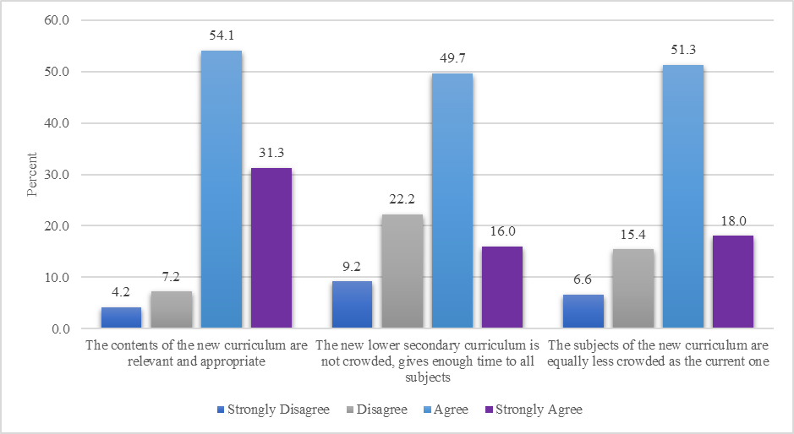
Perceived Relevance and Structure of the LSC
A significant majority (85.4%) agreed the contents of the lower secondary curriculum are relevant and appropriate.
Nearly two-thirds (65.6%) affirmed that the new lower secondary curriculum is not crowded and gives enough time to all subjects.

Slide 15
Teachers’ Motivation to Implement the LSC
More than a half (59.5%) of the teachers agreed that the teachers in their schools were motivated to teach the new curriculum
variations by school ownership (more private 61.1% than government 57.6%) and gender (more females 65.3% than males 57.2%)

Slide 16
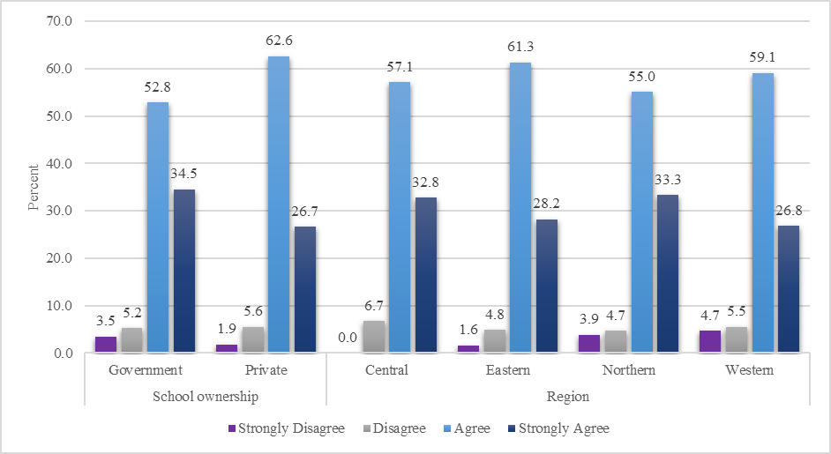
Perceived School Administrators’ Support for LSC
A greater majority (88%) agreed that their school administrators recognize the importance of the new LSC.
Slightly more teachers from private schools (89.3%) than government schools (87.3%) rated their school administrators as supportive.

Slide 17
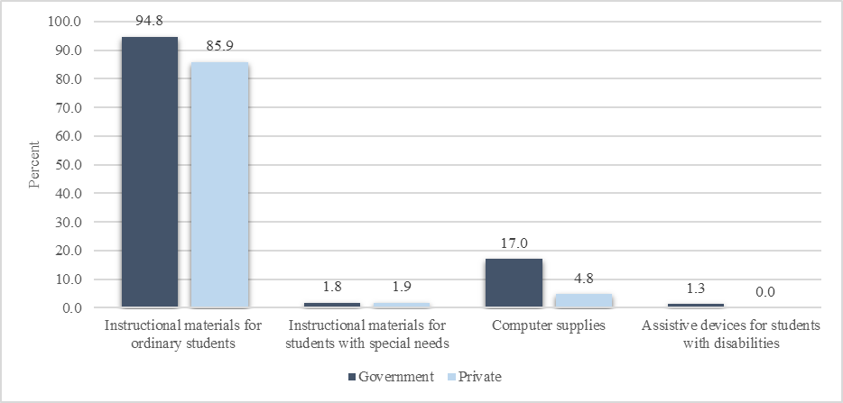
Support Received
The majority (90.0%) (85.9% private, government 94.8%) reported that their schools received instructional materials.
Unsurprisingly, significantly small proportion (1.8%) reported receiving instructional materials for students with special needs.

Slide 18
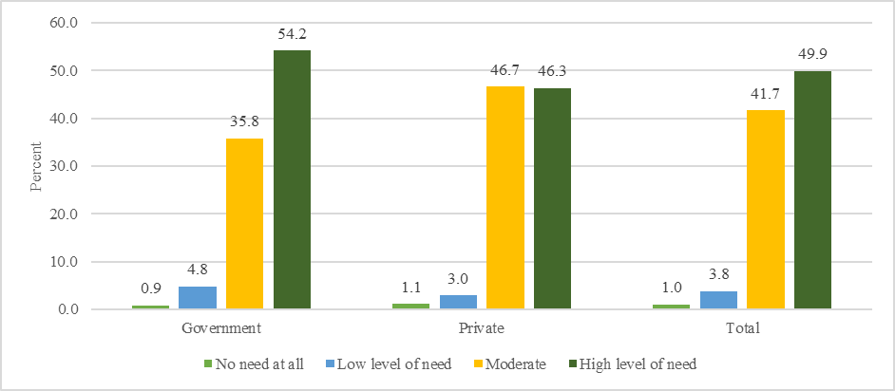
Teachers’ Support needs for CPD Training
Significant majority (91.6%) of teachers (49.9% a ‘high level of need’, moderate support 41.7%) in the subjects they teach.
Top 5 support needs are special needs (80.4%); assessment and reporting (79.4%); general science for students with special needs (78.0%); communicating in sign language (77.2%); communicating in braille (74.6%).

Slide 19
Key Take Home Messages
Teachers and school administrators understand the goal and objectives of the LSC and believe its contents are both relevant and less crowded than the previous/current curriculum.
Teachers have positive perception of supporting students with disabilities and other special needs but expressed the highest support needs in areas related to inclusive teaching pedagogy.
It is too early, to comment on the implementation status of the competency based LSC but perceptions of teachers give a picture of where we are likely heading.

Slide 20
Conclusion and Recommendations
Given the centrality of teachers the positive teachers’ perceptions of preparedness in this study signals a promising future for the implementation and likely success of the competency based LSC.
Deliberate interventions to be directed to the areas where teachers indicated the highest support need for continuous professional development e.g. inclusive education pedagogy.
Notes:
Similar study with a larger sample is needed midway of the LSC implementation to track progress and identify implementation bottle necks for corrective action.

Slide 21
Other papers

