Slide 1
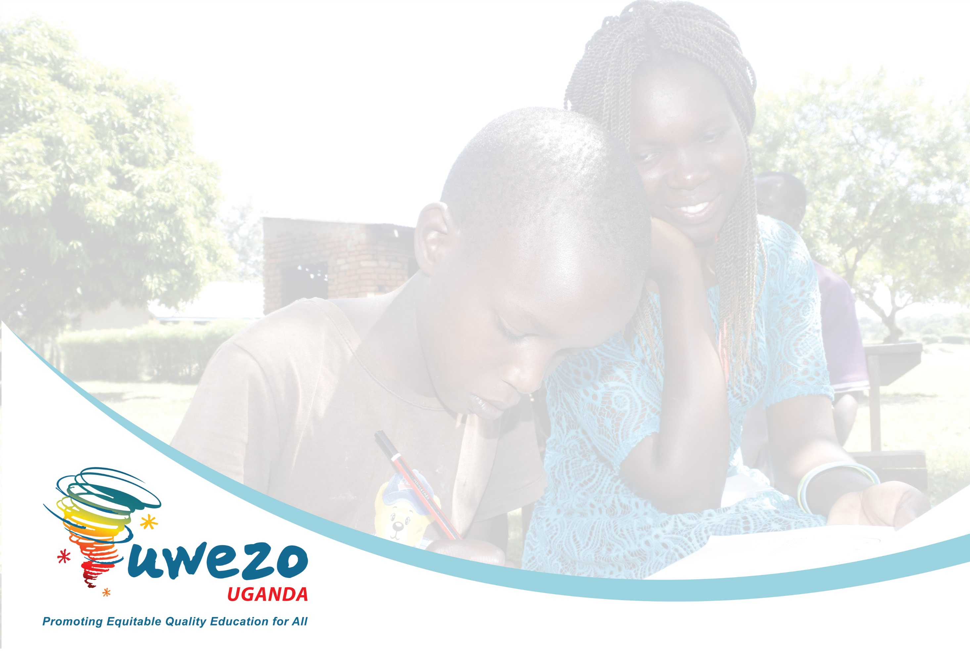
Are our Children Learning?
Evidence from the 2021 Uwezo Assessment
USAID/ICYD Meeting with Stakeholders- Lira
Highlight of Selected Findings Relevant to Leb Lango
23rd February, 2023

Slide 2
About the Uwezo 2021 Learning Assessment
# | Feature | Details
1 | Sample | 29 districts across the regions in Uganda Local language assessed in 12 districts 4 local languages assessed (Leb-lango, Luganda, Lusoga, Runyankore/Rukiga 15 Enumeration areas (EAs) in each district 20 households in each enumeration area All children aged 4-16 years
2 | Tool | Learning assessment in English, 4 local languages and numeracy Assessment items pegged on Grade 2 curriculum including pre literacy and pre-numeracy tasks Assessment tools developed by item writers, including curriculum/content specialists, assessment specialists, practicing teachers, researchers and teacher educators Items pretested and piloted Each assessment tool contained 2 samples of equal weight
3 | Process | One partner in each district [2 in Lango region; Oyam and Alebtong) Citizen volunteers with at least S4 level of education conduct assessment Assessments conducted one on one for each child in and out of school Largest school serving EA visited

Slide 3
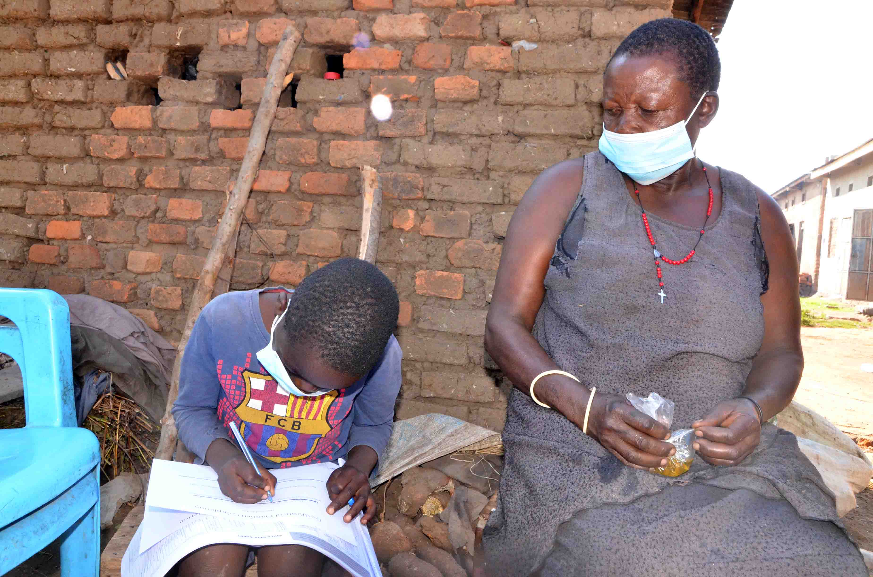

Slide 4
Uwezo 2021 Local Language Assessment Districts & Test Sample
1 | Leb-Lango | Two districts (Oyam and Alebtong)
2 | Luganda | Five districts (Mityana, Luweero, Mpigi, Bukomansimbi, Mukono)
3 | Lusoga | Five districts (Luuka, Mayuge, Jinja, Bugiri)
4 | Runyankore/Rukiga | Three districts (Ntungamo, Mitooma, Rukungiri)

Slide 5
Rates of full competence (read and comprehend) by grade for each local language
Language | Grade |  |  |  |  |  | n
 | P3 | P4 | P5 | P6 | P7 | Total (all p3-p7)
Leb Lango | 4.6 | 13.4 | 30.3 | 53.3 | 95.9 | 23.4 | 412
Luganda | 19.5 | 45.6 | 59.8 | 68.2 | 75.8 | 50.6 | 539
Lusoga | 0.7 | 4.2 | 10.5 | 28.3 | 46.1 | 13.1 | 628
Runyankore Rukiga | 14.6 | 31.9 | 57.2 | 60.3 | 78.7 | 40.3 | 734

Slide 6
Less than a quarter of the children in P3-P7 are able to read and comprehend
in Leb-Lango
More than 4 in every 10 learners are non—readers in Leb Lango (slightly more boys are non-readers).
n= 539

Slide 7
Approx. 5% of the children in primary 3 can read & comprehend
a text in Leb-Lango
District | Non reader | Letter | Word | Paragraph | story only | Read & Comprehend
ALEBTONG | 39.1 | 20.3 | 35.9 | 1.6 | 1.6 | 1.6 | 100
OYAM | 75.8 | 9.1 | 7.6 | 1.5 | - | 6.1 | 100
Total | 64.1 | 12.6 | 16.6 | 1.5 | 0.5 | 4.6 | 100
About 6 in every 10 children in Primary 3 are non-readers in Leb Lango
Oyam district has the highest proportion of Leb Lango non readers in Primary 3 (76%)…
^{n=130}

Slide 8
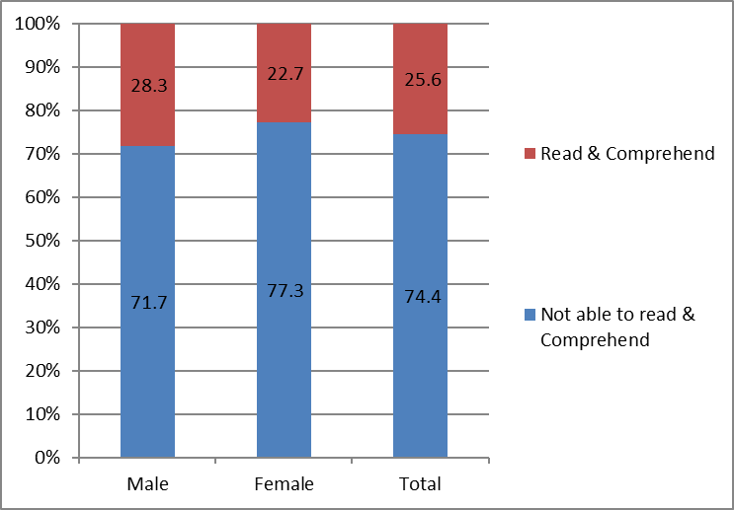

A quarter (25%) of the learners in P3-P7 can read and comprehend a Primary 2 text in English
  28% of the boys in Primary 3-7 can read and comprehend a primary two text in English
  There are slightly more boys than girls who can read and comprehend a primary two text in English
  The proportion of learners in P3-P7 who can read a text in English is almost similar to the proportion of those who can read and comprehend a text in Leb Lango

Slide 9
Ability of Children in P1-3 to Read Words and Do Subtraction, by School Languages of Instruction

Slide 10
Implications
How effective is the implementation of the mother-tongue policy?
Most schools are using a mixture of languages rather than a single language for instruction in P1-3
Use of a mixture seems to work better than the use of a local language only
The language policy requires careful attention and it must address important issues of equity
Performance on reading tasks in local language is equally low as is in English.
Attention is needed for programs that support improving reading including their effectiveness

Slide 11
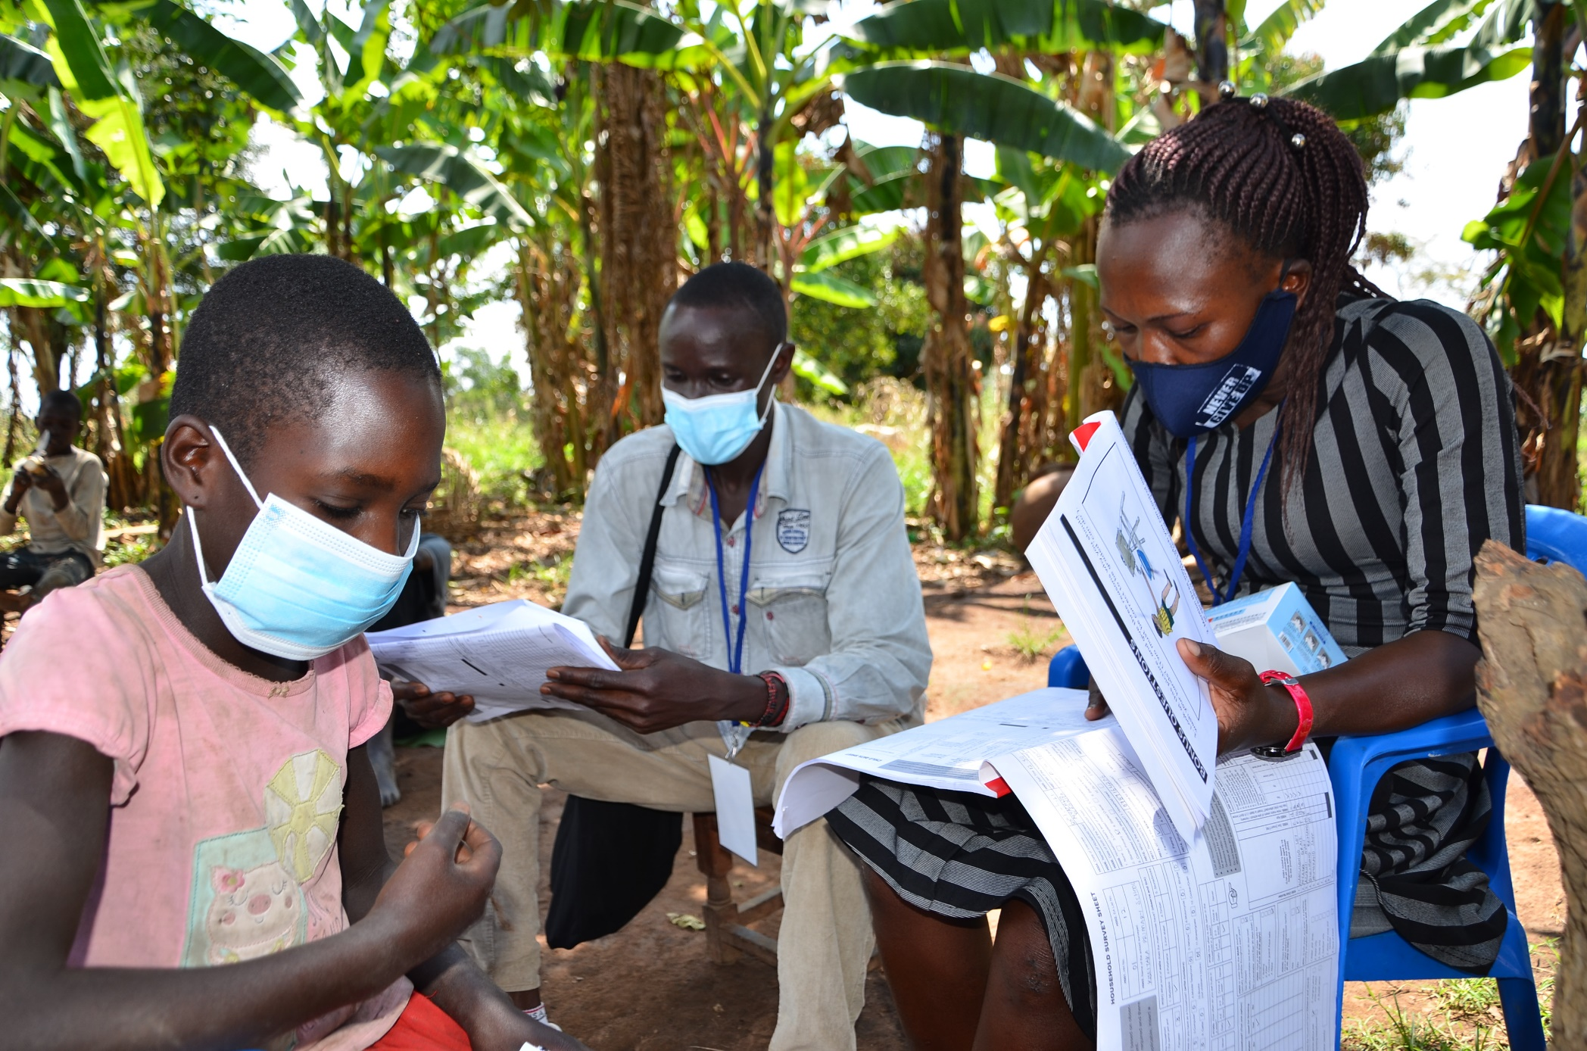

Slide 12
Thank you!
Contact Us!
Uwezo Uganda,
Corner House, Suite B1
Plot 436/437, Mawanda Road
Kamwokya, Kampala
P.O Box 33275, Kampala, Uganda
Tel: +256-393-193-441
E-mail: info@uwezouganda.org
https://uwezouganda.org/

