Slide 1
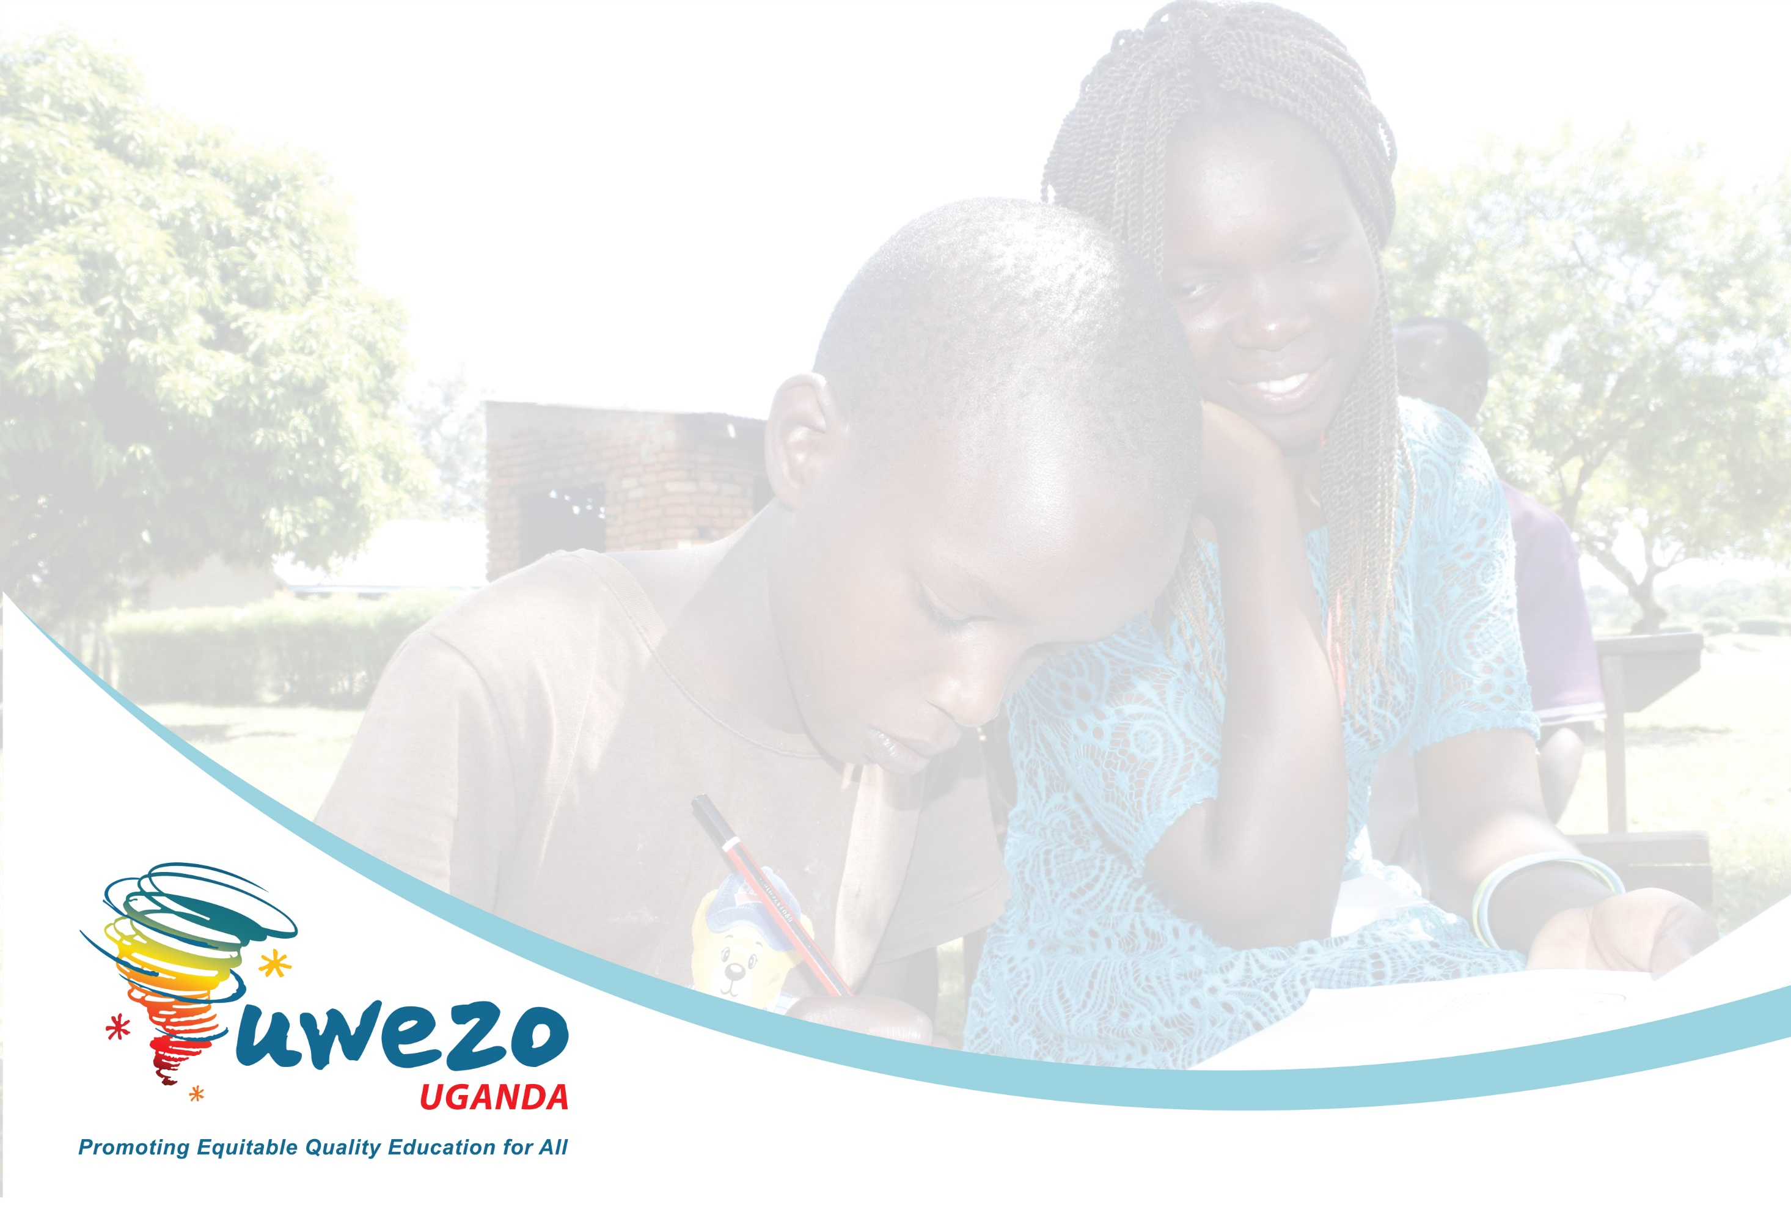
Are our Children Learning?
Evidence from the 2021 Uwezo Assessment
USAID/ICYD Meeting with Stakeholders- Gulu
Highlight of Selected Findings Relevant to Leb Acholi
21st February, 2023

Slide 2
About the Uwezo 2018 Learning Assessment
# | Feature | Details
1 | Sample | 32 districts across the regions in Uganda Local language assessed in 13 districts 4 local languages assessed in the 13 districts (Leb-Acholi, Luganda, Lusoga, Runyankore/Rukiga 30 Enumeration areas (EAs) in each district 20 households in each enumeration area All children aged 6-16 years
2 | Tool | Learning assessment in English, local languages (4) and numeracy Assessment items pegged on Grade 2 curriculum Assessment tools developed by item writers, including curriculum/content specialists, assessment specialists, practicing teachers, researchers and teacher educators Items pretested and piloted Each assessment tool contained 3 samples of equal weight
3 | Process | One partner in each district Citizen volunteers with at least O level of education conduct assessment Assessments conducted one on one for each child in and out of school Largest school serving EA visited

Slide 3
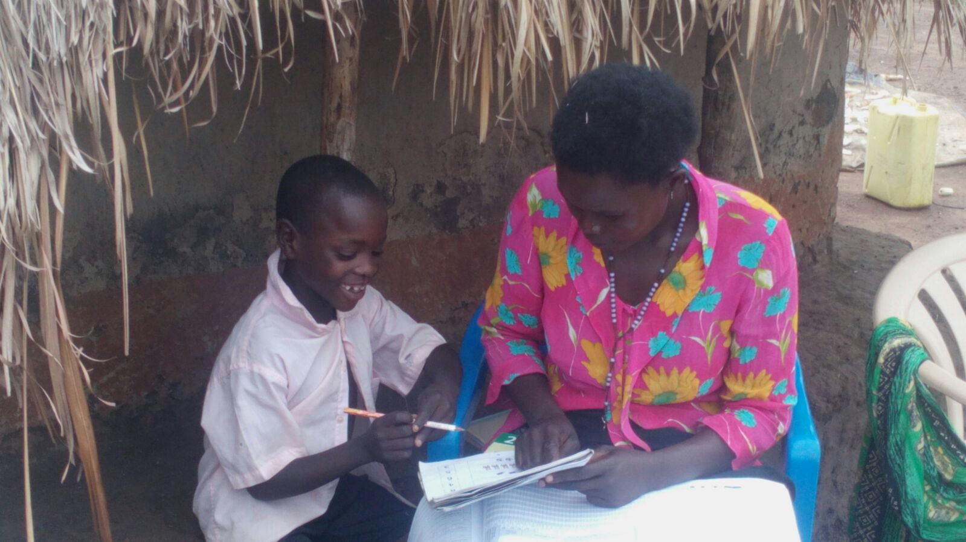

Slide 4
Uwezo 2018 Local Language Assessment Districts & Test Sample
1 | Leb-Acholi | One district (Amuru)
2 | Luganda | Five districts (Mityana, Luweero, Mpigi, Bukomansimbi, Mukono)
3 | Lusoga | Five districts (Luuka, Mayuge, Jinja, Bugiri)
4 | Runyankore/Rukiga | Three districts (Ntungamo, Mitooma, Rukungiri)

Slide 5
Rates of full competence (read and comprehend) by grade
for each local language
Language | P3 | P4 | P5 | P6 | P7 | All P3 - P7 | n
Acholi | 4.4 | 10.8 | 24.4 | 42.0 | 71.4 | 20.4 | 514
Runyankole/Rukiga | 17.2 | 38.8 | 45.9 | 67.7 | 76.8 | 43.5 | 925
Luganda | 26.1 | 30.2 | 42.4 | 50.0 | 72.7 | 38.6 | 1,784
Lusoga | 1.9 | 3.5 | 9.8 | 14.7 | 28.8 | 8.5 | 1,956
All | 14.6 | 21.1 | 30.6 | 41.7 | 57.3 | 28.1 | 5,179

Slide 6
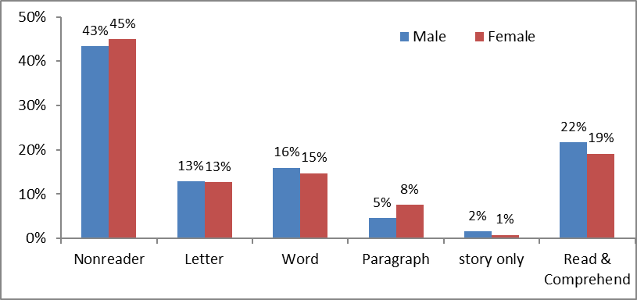
About 2 in every 10 children in P3-P7 are able to read and comprehend in Leb-Acholi
n= 514
There are more than 4 in every 10 learners who are non-readers in Leb Acholi with slightly more girls being non-readers).

Slide 7
Approx. 4% of the children in primary 3 can read & comprehend a text in Leb-Acholi
Class | Non reader | Letter | Word | Paragraph | story only | Read & Comprehend | Total
P3 | 60.1 | 20.3 | 9.4 | 5.1 | 0.7 | 4.4 | 100
^{n=138}
Close to 6 in every 10 children in Primary 3 are non-readers in Leb Acholi

Slide 8
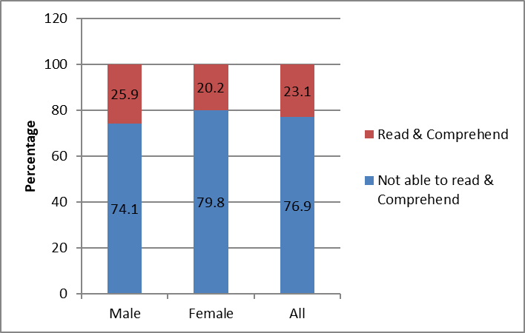

Less than a quarter (23%) of the learners in P3-P7 can read and comprehend a Primary 2 text in English
  There are slightly more boys than girls who can read and comprehend a primary two text in English
  The proportion of learners in P3-P7 who can read a text in English is almost similar to the proportion of those who can read and comprehend a text in Leb Acholi

Slide 9
Ability of Children in P1-3 to Read Words and Do Subtraction, by School Languages of Instruction (2021)

Slide 10
Implications
Performance on reading tasks in local language is equally low as is in English.
Reflection is needed on the effectiveness of the implementation of the mother-tongue policy?
Most schools are using a mixture of languages rather than a single language for instruction in P1-3
Attention is needed for programs that support improving reading including on their effectiveness

Slide 11
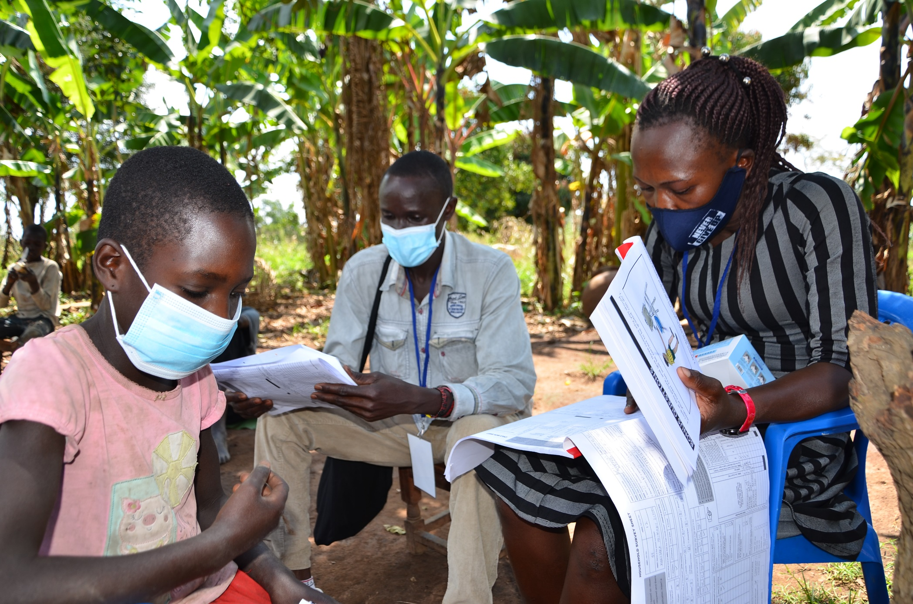

Slide 12
Thank you!
Contact Us!
Uwezo Uganda,
Corner House, Suite B1
Plot 436/437, Mawanda Road
Kamwokya, Kampala
P.O Box 33275, Kampala, Uganda
Tel: +256-393-193-441
E-mail: info@uwezouganda.org
https://uwezouganda.org/

