Slide 1
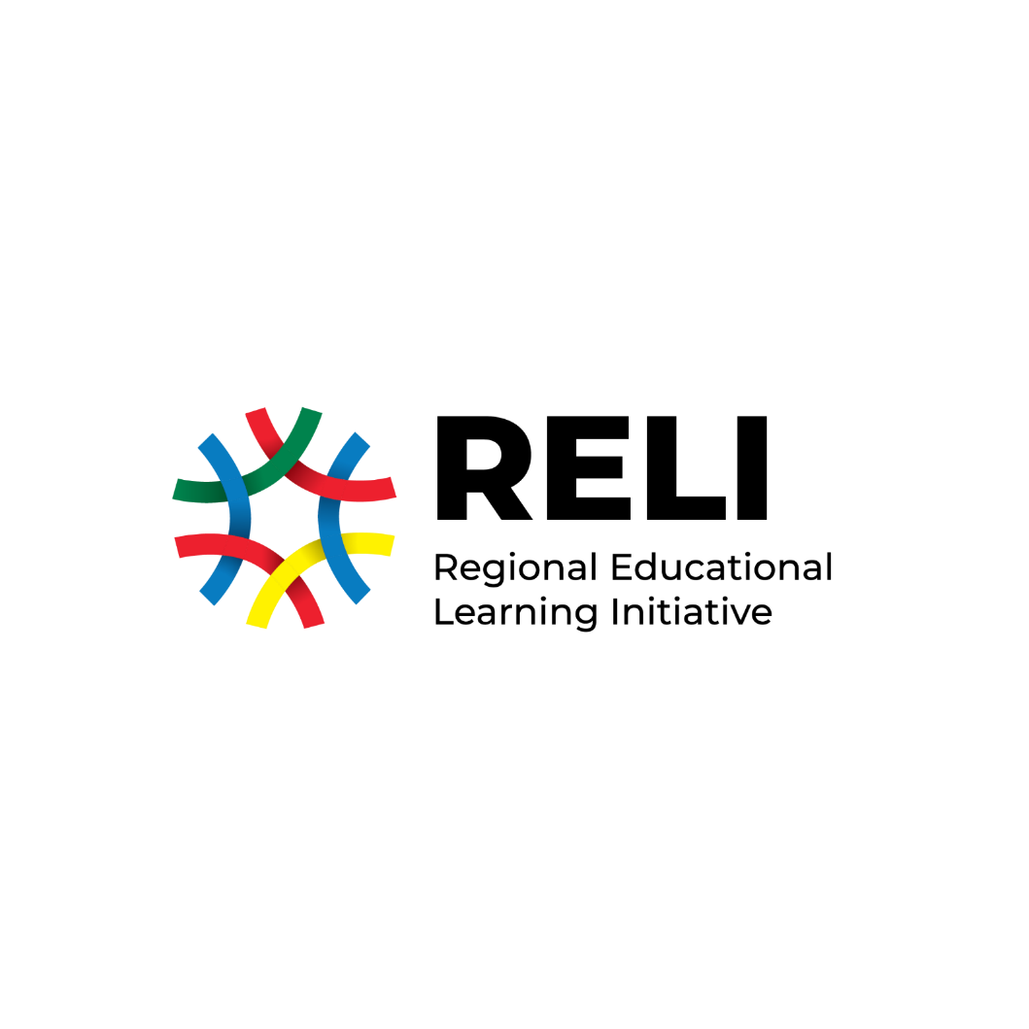
ASSESSMENT OF LIFE SKILLS AND VALUES IN EAST AFRICA
A participatory approach to developing contextualized tools for assessing life skills and values: The process and lessons from East Africa
CIES 66th Annual Conference
Mon, April 18 2022
Mary Goretti Nakabugo – Uwezo Uganda
Martin Ariapa – Luigi Giussani Institute of Higher Education
Purity Ngina – Zizi Afrique Foundation

Slide 2
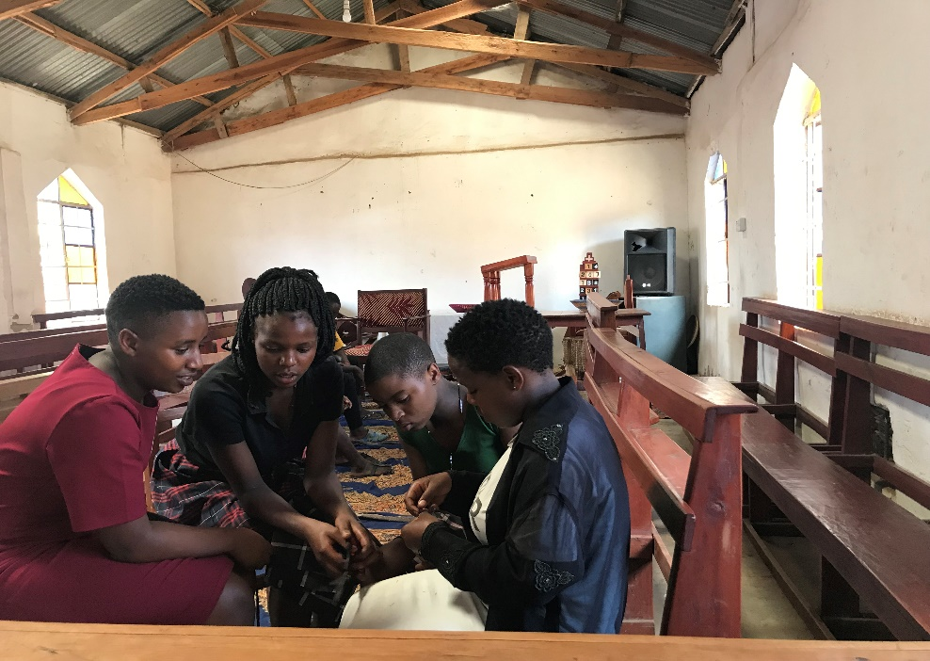
Presentation Outline
Background to the ALiVE
ALiVE tool development process
Lessons learnt

Slide 3
Background to the ALiVE
Accordingly, it is still unclear how these skills have been assessed, let alone understood and defined in the East African context (Wamahiu & Bapna, 2019).
Despite the global concern for life skills education, the nature and definition of life skills greatly varies across cultures and countries (Bwayo, 2014; McMullen & McMullen, 2018).
Life skills education is critical for the development of children’s interpersonal and psychosocial skills (UNICEF, 2012; WHO, 1999).
**Against this backdrop, RELI established an initiative, ALiVE, to contribute to increased education system focus and capacities to assess and nurture life skills and values.
Notes:
RELI – Regional Education Learning Initiative
ALiVE – Assessment of Life Skills and Values in East Africa

Slide 4
ALiVE Tool Development Process
Prioritization
Reviewed the landscape of the education systems in the 3 countries [KE, UG, TZ]
Contextualization
Conducted rapid ethnographic interviews with adolescents, parents, and key persons across 15 districts in KE, UG and TZ.
Literature review
To establish how the competences were defined and framed in other contexts
Agreed on 3 life skills [problem solving, collaboration, self-awareness and 1 value (Respect)
The process generated in-depth understanding of the four competences.
To compare and validate the contextualized understanding against the documented evidence.
To build the capacity of the various partners in designing and conducting a literature review.

Slide 5
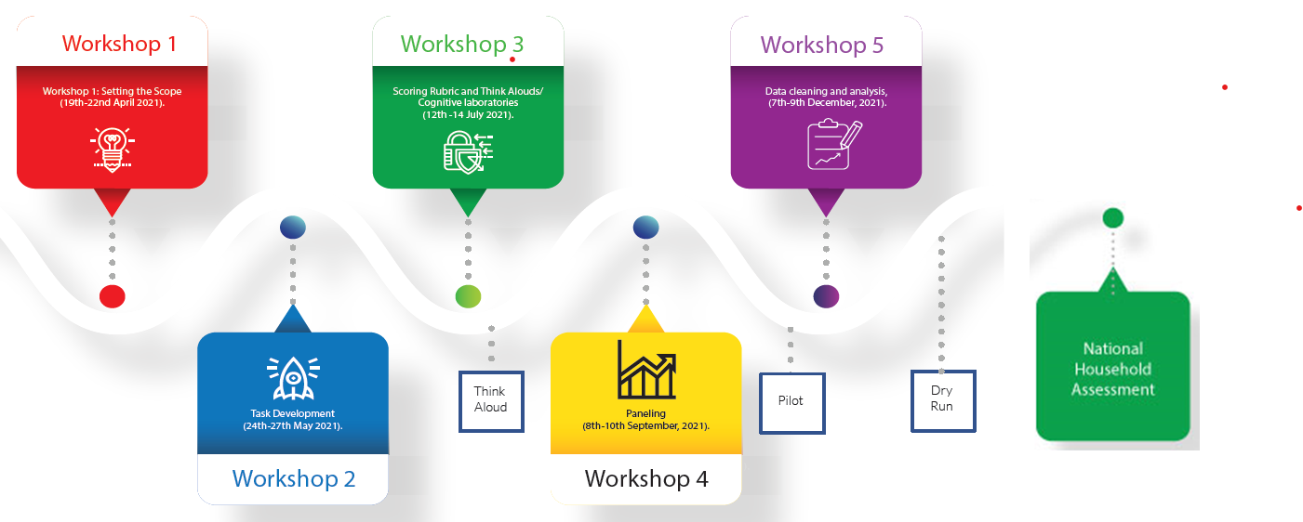
ALiVE Tool Development Process

Slide 6
Lessons Learnt from ALiVE
Think aloud and pilot activities
The processes facilitated understanding of how the tasks and items were context relevant and age appropriate. Also, facilitated the reduction of the tasks and items.
Advocacy and policy influence
The inclusion of policy actors into the assessment development process is key, however, better capacities to sustain the coordinated engagement is needed.
Assessment at classroom level
Coupling this household based assessment with system-focused and school-based assessments may accelerate resonance with teachers and education officials to assess life skills at classroom level.
Contextualization + Literature review
The nature and definitions of life skills varied across cultures and countries. This revealed the importance of creating context relevant tasks and items.
Oral think aloud is complex but doable.
Learning through doing
The tool development involved getting introduced to a specific aspect by the facilitator, working on it, and receiving questions and reviews from the facilitator. This process has facilitated learning.
Notes:
Problem solving: The literature conceptualises problem solving as a process that involves very specific steps in the process of facing challenges. In the contextualization study, some of the steps were not highlighted. Additionally, Tanzanians did not elaborate much on the aspect of identifying and choosing the best solution to the problem.
Collaboration: The literature leads to a consensus around the definition of collaboration as ‘working together to achieve a common goal’. In the contextualization study, the aspect of achieving a common goal is absent, or is described otherwise. The participants often referred to the achievement of the common good of their community.
Respect: In the literature the aspect of ‘respect for the environment emerged’. In the contextualization study, this did not emerge.
Self-awareness: In regards to the definition of self-awareness, ‘taking care of self’ is one of the aspects that prominently emerged among the participants from Uganda. Participants alluded to the fact that a self-aware individual is capable of making careful choices on pertinent issues of health and psychological well-being.

Slide 7
Let’s Walk Together
Follow us on:
Email info@ziziafrique.org
Website https://reliafrica.org/alive/
Assessment of Life Skills and Values in East Africa -ALiVE
Notes:
ALiVE is supported by Wellspring Philanthropic Fund, Achidna Giving, Imaginable Futures and Lego Foundation

