Slide 1
Accelerated Return on Investment in Education through Provision of Pre-primary Education in Uganda: Evidence from Uwezo Learning Assessments
Mary Goretti Nakabugo, James Urwick, Amos Kaburu & Faridah Nassereka, Uwezo Uganda
The 2023 National Demographic Dividend Conference
3-4 May 2023, Hotel Africana, Kampala, Uganda

Slide 2
Background: education and change in the age structure
For low-income countries, both improved education and a reduced child dependency ratio are important for economic growth (see Kotschy et al., 2020).
Education can contribute to:
A reduction of the fertility rate
Increased work time for parents
Workforce productivity
Families with fewer dependents can usually invest more per person in education.

Slide 3
Path diagram for changes producing a ‘demographic dividend’
More effective education and health care:
Expansion of basic education
Reduced child mortality
Increased ed. attainment
Reduced fertility rate
Benefits favouring economic growth:
A more productive workforce
Reduced child dependency ratio
Intermediate factors:

Slide 4
Uganda is far from meeting the requirements for rapid economic growth and development:
Primary education continues to be inefficient in the following ways:
Achievement of basic literacy and numeracy is delayed and incomplete, as shown by Uwezo assessments. This delays the transition from school to work.
Grade repetition increases costs, especially in the lower primary grades.
The survival rate to P7 is low (32% in 2016).
The child dependency ratio remains very high (88.5%) and there is no national population policy.

Slide 5
The potential value of public investment in early childhood care and education (ECCE) (for ages 3-6)
We identify this kind of investment as one of the key responses to the inefficiency of primary education.
Although we adopt an efficiency perspective here, we also consider that ECCE should be treated as a right of children.
We focus here on the benefits of ECCE for later learning, but we do not regard school readiness as its sole purpose.

Slide 6
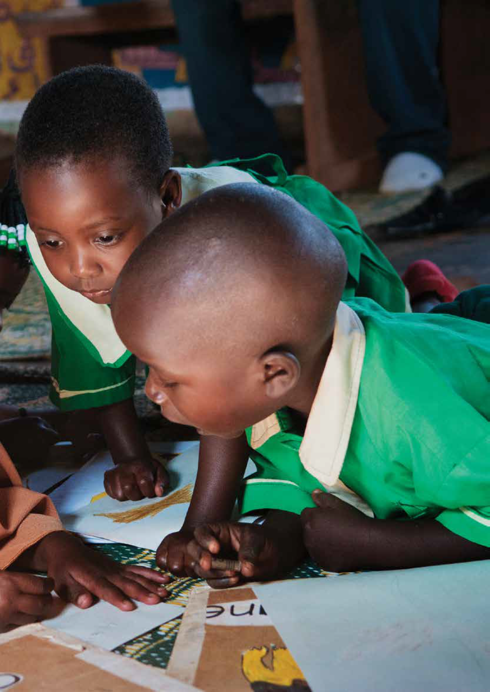
Importance of preschools - even at low cost they can make a difference to children’s
General cognitive skills
Literacy and numeracy skills
Emotional development
Social competence
Physical wellbeing

Slide 7
Children Aged 6-14 in Uganda: Est. Percentages by Years of Preschool Experience (2018)
No. Years | 0 | 1 | 2 | 3+ | Total
Percentage | 38.3 | 12.7 | 17.2 | 31.8 | 100.0
Notes:
N=24,722

Slide 8
Challenges of early childhood care and education (ECD/ECCE) in Uganda
Provision is explicitly left to private providers (Education Act of 2008)
Many households cannot afford preschool fees
The quality of the service is very varied
Much of the training of staff is left to private providers
Regulation and supervision is weak: many preschools are not registered or officially recorded
Notes:
As noted by Dr Pamela – access is still a challenge

Slide 9
Lower-level outcomes considered
Proportions of primary pupils aged 6-14 able to:
Read words in English
Do simple subtraction (without borrowing)

Slide 11
Implications
Children seem to be learning faster in primary school as a result of the preschool experience.
The marginal effect of the preschool experience seems to be larger than that of attending a private primary school.
But, to be sure, we need to control for other influences.

Slide 12
Higher-level outcomes considered
Proportions of primary pupils in P3-P7 able to:
Read and comprehend a short story in English (P2 level)
Perform a division task (dividing a two-digit number by a one-digit number, with no remainder, P2 level)

Slide 13
Rate of competence in English reading by preschool experience and by household wealth group (2021)
Weighted percentages are shown for children in P3-P7 and represent competence at P2 level. Sample size = 4,149
Preschool experience | Wealth group:
 | Low | Middle | High | Total
0-1 years | 24.5 | 27.6 | 38.8 | 29.5
2-4 years | 32.3 | 39.3 | 53.9 | 46.5
Total | 27.7 | 33.7 | 50.3 | 39.7

Slide 14
Rate of competence in numeracy by preschool experience and by household wealth group (2021)
Weighted percentages are shown for children in P3-P7 and represent competence at P2 level. Sample size = 4,174.
Preschool experience | Wealth group:
 | Low | Middle | High | Total
0-1 years | 41.5 | 42.0 | 51.9 | 44.5
2-4 years | 45.0 | 47.1 | 58.4 | 53.2
Total | 42.9 | 44.7 | 56.8 | 49.8

Slide 15
Implications of the cross-tabulations
Within each of the three household wealth groups, having at least two years of preschool experience is consistently associated with a higher rate of competence, both in reading and in numeracy. The effect cuts across all wealth groups.
The inequality of outcomes that is attributable to wealth is mitigated by preschool experience.

Slide 16
A research finding from further analysis of Uwezo’s 2018 assessment data:
A child in Uganda, aged 6-14, who has attended preschool for two years or more is 1.9 times more likely to be able to read words in English reading competence (Grade 2 level) than one who has not, and 1.6 times more likely to be able to do subtraction, where other relevant factors are controlled.
The factors controlled included grade level, private primary school and household technology.

Slide 17
Why does ECCE make a difference? Some hypotheses
Even though many ECD centres have underqualified teachers and very limited resources:
Classes are smaller than those in P1-P3 and children receive more individual attention. This helps them to survive in P1-P3.
Children develop social skills that are beneficial for later learning.
With public investment in ECCE, these advantages could be still greater.

Slide 18
To make ECCE more accessible and consistent in standard, we recommend:
Public subsidy of non-profit preschools, with reduction of the cost to households.*
A strong role for local communities in the management of preschools.
Expanded training of teachers and assistants for this level and reasonable (not excessive) qualification requirements.
Notes:
*For community-based ECD centres, we recommend a capitation grant of UGX50,000 per term.

Slide 19
Thank you!
Contact Us! Uwezo Uganda,
Corner House, Suite B1
Plot 436/437, Mawanda Road
Kamwokya, Kampala
P.O Box 33275, Kampala, Uganda
Tel: +256-393-193-441
E-mail: info@uwezouganda.org
https://uwezouganda.org/

Slide 20
Comments from the presentations
Life cycle approach:- Planners: Are we looking for the populations we are planning for? Majority of them are children!
We need to plan for this population
Are the developers aware of the needs of the population?
We tend to plan nationally, but we need to be mindful of the peculiarities of different districts
78% of our population is below 30 years
Key sectors for harnessing DD: Health, education, Labour market, Women empowerment, Maternal and child health, governance

Slide 21
We need to change the way we are teaching children, invest in ECD, invest in vocational education, devise strategies to retain children school for at least 13 years
Now we plan by program not sectors (NDPIII)
Hon. Omagollo of Bungokho: When are we going to decentralize such conferences to address the real people who are facing these challenges
It is multi-sectoral – but how do we move to create the linkages?
Doris Abalo: staff gaps, parental engagement
Okello Fred: employment: retirement age limit should be reduced
Hon Donald: National consultations are being done at the tail end of the planning process. What are the implications of the homosexuality bill?
Pastor Mikisa: The size of the population doesn’t matter but its quality. Religious organisations have a bias against contraceptives. Federalism.
Luyima Moses:
Commissioner Mondo (my Mulamu): Family planning; parenting is critical; Put ECD in NDP111, policywise ECD is catered for, but not putting money in ECD. And yet evidence is in our face that investing in ECD is the way to go.

Slide 22
Final questions
What is a 13 year doing in the community during school time? What is a 13 year doing in a maternity ward?
Instead of calling it family planning, call it planning for the family

